Slide 1
Dealerships of the Future The Outlook of the Industry

Slide 2
Speakers

Slide 3
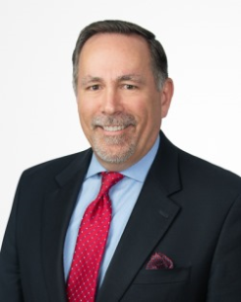
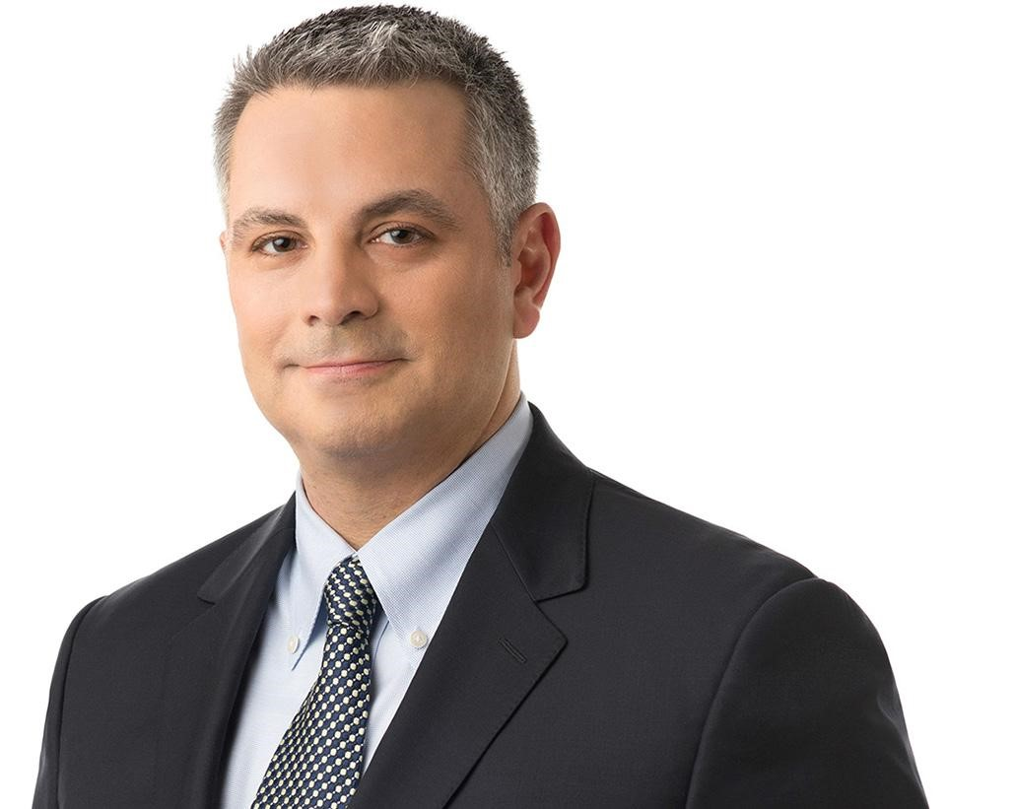
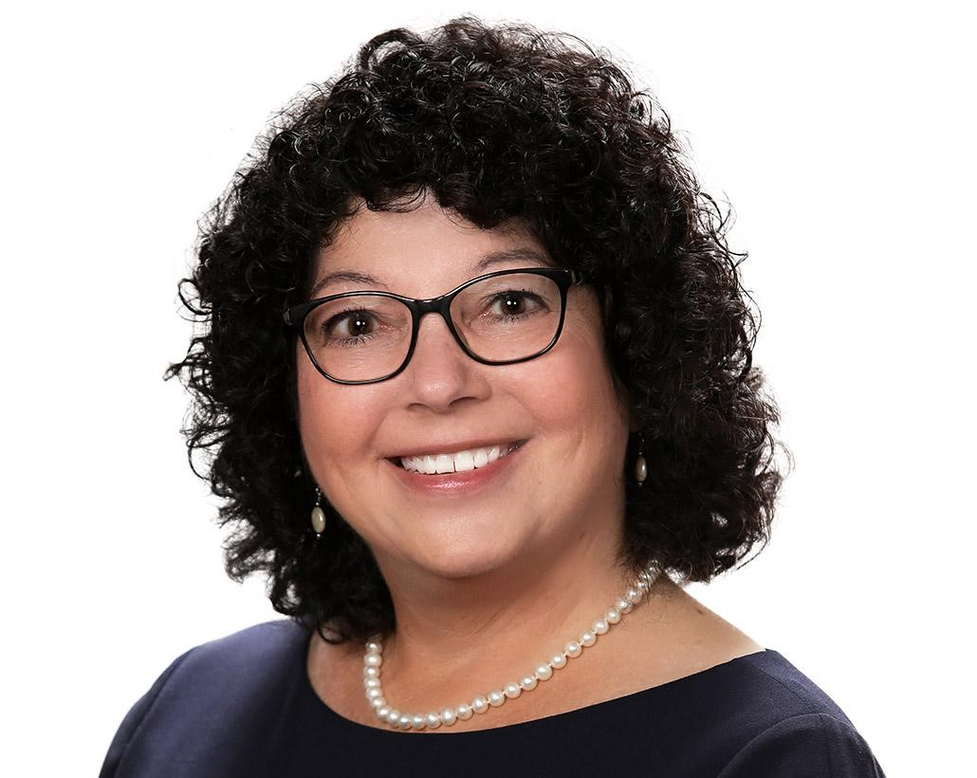
Dealerships of the Future – The Outlook of the Industry
Chris Genovese Jody Porter John Skelton

Slide 4
Agenda – Dealerships of the Future
01 | The Auto Industry is Evolving
02 | Dealerships are Changing
03 | What Does it Mean -- Implications for the Industry

Slide 5
The Auto Industry is Evolving

Slide 6
The Auto Industry is Evolving
Five significant changes in the Auto Industry
Change No. 1: Dealership consolidation
Change No. 2: Consumer desires / expectations
Change No. 3: More on-line transactions / digital retailing
Change No. 4: EVs, AVs, new entrants and all things “Tesla”
Change No. 5: Enhanced consumer protection / FTC Enforcement

Slide 7
The Auto Industry is Evolving
Change No. 1: Dealership consolidation and growth of Dealer Groups
Reuters, March 2, 2022 - “Big U.S. auto dealers bet billions against the death of the dealership”
$8 billion in value transferred in 2021– triple the $2.5 billion of value sold in 2020
338 unique transactions in 2021 v. prior peak of 288 in 2020
Publicly traded dealer groups bought over 250 dealerships in 2021
Per USAI – approximately same number of rooftops which means retail infrastructure remained the same while ownership consolidated
CEO of Asbury: Fewer owners, owning more stores

Slide 8
The Auto Industry is Evolving
Dealership consolidation means change
Traditional Dealer Model:
Privately-held single (or multiple) dealership
Family-owned business passed down to children
OEM focused on the experience, personal services and expertise of the individual owner / operator
Now:
The Publics (AutoNation, Sonic, Asbury, etc.)
Privately held dealer groups with large portfolio of multiple brands
Privately held dealer groups owned / controlled by Private Equity Investors
ESOPs (small, but growing)

Slide 9
The Auto Industry is Evolving
Record growth and consolidation
AutoNews, May 2, 2022 - “Asbury Automotive Poised to Overtake Rivals”
Asbury raised 2025 revenue goal 60% to $32 billion -- $6.2 billion to come from buying more dealerships
Asbury’s plan includes adding 75 more dealerships
Asbury forecasts having 225 dealerships by 2025 up from 148 today. Asbury had 91 dealerships in 2020
Asbury reported Q sales of 39,174 – 44% increase from Q1 2020
Lithia also reports aggressive growth targets -- $50 billion in revenue by 2025
AutoNews – September 20 – Lithia buys 5 dealerships in Wisconsin.
Evolving owner models present challenges for OEMs
Potentially unknown owners / investors
Influence / control by non-automotive owners/management
Business objectives (e.g., return on investment and exit strategies) potentially at odds with OEM objectives (investment in brand and performance)

Slide 10
The Auto Industry is Changing
Change No. 2: Changing Consumer desires / expectations
Customers want: Choices; Convenience; Competition; Communication; and Computerization
Deloitte – 2022 Key consumer trends (globally):
Many expect advanced technologies as part brand differentiation
Interest in EVs primarily driven by perceived lower running costs, environmental consciousness and better driving experience – but driving range and charging infrastructure remain barriers
While shift to digital and on-line, many still want aspects of in-person purchase experiences
Post-pandemic -- personal vehicles, not shared mobility, continues to be the preferred mode of transportation
OEMs and Dealers need to react to evolving customer desires / expectations

Slide 11
The Auto Industry is Changing
Change No. 3: Evolution to on-line and digital retailing
Digital Retailing is doing everything—or almost everything—“online” that traditionally has been done “on site” at the dealership
Different from “direct sales”
COVID 19 – sharpened customer preference for digital and on-line
Good for dealers (per NADA Survey):
Dealers with digital retailing capability reported higher GPPV
Average units delivered per salesperson doubled, from 9 to 18
Virginia Automobile Dealers Association CEO Don Hall – Dealers must evolve or risk becoming “dinosaurs” (Daily Drive Podcast)

Slide 12
The Auto Industry is Changing
Change No. 4: EVs, AVs, new entrants / “Tesla” and “Green” Regs.
Every major OEM now has an EV strategy with Tesla, new entrants fueling more focus on direct sales and alternative distribution models
Transition from ICE to EVs changing the traditional dealership. Reuters, March 2, 2022 Article
CEO of Asbury: "If you know the world is going to be electric ... you don’t need stores to be as big as they are. Maybe a small showroom ... and smaller service centers" in more locations
Lithia’s Bryan DeBoer noted potential support of “Agency Model” where dealers are paid set amounts to handle sale (and avoid significant SG&A costs) and deliver car without need to stock significant inventory
Emerging “green” regulations – Inflation Reduction Act
Expanded tax credits for EVs -- $4,000 for the sale of used electric cars and up to $7,500 for purchaser of certain new EVs.
Clean vehicle credits (final assembly, critical minerals and battery components inn North America )
Tax credit for charging equipment extended through 2032
Emerging “green” regulations -- California ICE Regulations
2035 ban on ICE new cars / interim targets
Cities pushing to ban gas stations

Slide 13
The Auto Industry is Changing
Change No. 5: Enhanced consumer protection / FTC rule – enforcement
April 1, 2022, the Federal Trade Commission (FTC) and Illinois Attorney General’s Office -- $10 million settlement with Ed Napleton Automotive Group re: advertised pricing for vehicles
FTC Rule coming
Expect more consumer favorable scrutiny / regulation of Auto Industry

Slide 14
Dealerships are Changing

Slide 15
Dealerships are Changing
What will the dealership of the future look like? Operationally how will it change?
Amazon influenced other stores like Walmart and Target to focus on-line, create advantages / rewards, quick delivery, no hassle buying. Start-ups doing the same in the auto industry.
Some certainties: EVs, on-line vehicle shopping, and a focus on customer convenience
Ultimately Dealerships and OEMs will need to deliver what customers want

Slide 16
Dealerships are Changing
Lessons from Start-Ups
Focus on experience centers more than transaction centers
Less inventory
Fewer brick-and-mortar sales locations
EV-only brands
Consistency of messaging / advertising
Transparency in pricing
Mobile Service

Slide 17
Dealerships are Changing
COVID and Supply Constraints have accelerated the rate of change.
Enhanced Online Experience
Remote Test Drives
Home Delivery
Different service options
Increased use of Apps

Slide 18
Dealerships are Changing
Enhancing the online experience:
Digital retail is here to stay
Continued drive towards offering all aspects of the purchase process online: financing, reviewing trade offers, eSign and notarized sales docs.
Continued use of data to better understand specific customers needs
Digital Enhancements-Role of Augmented and Virtual Reality: 3D test-driving experiences, 360-degree videos of a vehicle's interior and exterior.
Customization of product
The ‘Amazon effect’ of seeing, buying and having a product delivered to your doorstep has made its way into vehicle buying and it is here to stay.

Slide 19
Dealerships are Changing
Shift from Transaction Centers to Experience Centers.
Continued desire of consumers to be able to see, touch, and experience the vehicle.
Test drives will remain a key part of the experience
Salespeople as “Product Experts” - With continued push towards EVs and advanced technology it will be more important than ever to have a product expert educate customers.
Use of charging stations

Slide 20
Dealerships are Changing
Reduced Dealer Inventory
Customization
More and more vehicles being built to order
The number of consumers that plan to preorder their next vehicle through a dealer continues to grow
Consumers willing to wait to get a vehicle that fits their exact specs: colors/trim/ add-ons/ features
As a result, in the future, dealerships will generally have fewer cars on their lots
Talk within the Industry (e.g. Ford, Polestar)

Slide 21
Dealerships are Changing
Dealer as a Concierge - Continued movement towards hassle-free, convenient sales/service process:
Remote Test Drives- Dealer allows the customer to schedule and dealership deliver the car to the customer to test drive at a location of their convenience.
White Glove Delivery - Make it an experience
Mobile Service – Service performed at home/work
Continued need to service ICE vehicles along with EVs

Slide 22
Dealerships are Changing
Transparent Pricing
Movement towards “No Haggle” sales experience.
Automotive News 9/14/22: “Ford told dealers they have to set no-haggle prices on EVs and follow other new standards aimed at competing with direct-sales rivals such as Tesla.”
Generational Differences in Consumer Preferences? “Non-Haggle” vs. the value of negotiations

Slide 23
Dealerships are Changing
Dealers and OEMs need to provide / add value to the customer’s experience
Both dealers and OEMs want to build the relationship with the customer
OEMs selling more products and services directly to the customer
Dealers partnering with mobility companies, creating subscription programs, mobility fleet management
Manufactures/dealers must proactively prepare for a radically different future in which only forward-thinking businesses thrive.

Slide 24
What Does It All Mean – Implications for the Industry

Slide 25
What does it all mean – Implications for the Industry
The seven words that will define the future
o State v. Federal laws
o Sustainability
o Software
o Service
o Sourcing/Supply
o Smart Roads
o Success

Slide 26
What does it all mean – Implications for the Industry
State v. Federal Laws
Auto industry has been defined mostly by state laws, but new innovation will demand integration of systems and accessibility of information
Will we continue to see a patchwork of state laws on direct sales or will we see federal legislation?
Will lawsuits that argue direct sales bans violate the Commerce Clause of the U.S. Constitution succeed?

Slide 27
What does it all mean – Implications for the Industry
Sustainability
It’s more than just EVs
OEMs re-evaluating everything from design through product end-of-life
OEMs embracing new ways of generating energy and “sharing” that energy within bi-directional chargers, sustainable communities and residential battery storage units

Slide 28
What does it all mean – Implications for the Industry
Software
Customers are looking for more than reliable vehicles; they want the latest technology
Three layers of products—hardware, software and apps
Customers want comfort, performance, and convenience
Challenges will include:
OTAs
Who owns customer relationship?
Additional costs for subscriptions?
Privacy and data security

Slide 29
What does it all mean – Implications for the Industry
Service
While much of the talk is about direct sales, reduced inventory and supply chain issues -- real challenge is service
Customers demand convenience, but the industry is moving toward fewer points
Customers want mobile service, but is it environmentally sustainable?
Are technicians prepared to service EV cars and trucks?
Will the industry and customers turn more to third-party providers?

Slide 30
What does it all mean – Implications for the Industry
Sourcing
Continued challenges in the supply chain
New regulations requiring North American focus
Inflation Reduction Act—EV tax credits
New battery factories
OEMs need to become experts in materials mining (e.g., lithium)
Move toward “glocalization”
Logistics and freight challenges

Slide 31
What does it all mean – Implications for the Industry
Smart Roads
We already have:
Vehicles reading speeding limits and speed limiters
Vehicle to vehicle communication
Information about parking availability
E-tolls
Remote parking assist systems
What does the future hold?
Smart pavement with fiber-optic sensors
Solar road paint
Roads that Honk
Digital traffic signs
Roads that harvest energy
Smart streetlights
Smart intersections

Slide 32
What does it all mean – Implications for the Industry
Success will depend upon:
Who harnesses the technology of the future
Who harnesses the energy of the future
Who builds relationships with the customers of the future

Slide 33
Questions?

Slide 34
Thank You

