Slide 1
Framing the Future: Electronic Title and Vehicle Records Management
National Association of Motor Vehicle Boards and Commissions
September 22, 2022
Nashville, TN

Slide 2
Definitions to Consider
EVR/ERT – Electronic Vehicle Registration System
Documents needed to register/title a vehicle are converted to electronic format to submit to the MVA – often consist of scanned forms
ELT – Electronic Lien and Title
Electronic notifications from lender to MVA related to perfecting, updating, and releasing liens on a vehicle record
E-Title – Electronic Title
The electronic record (digital data) of vehicle ownership recorded by the MVA.

Slide 3
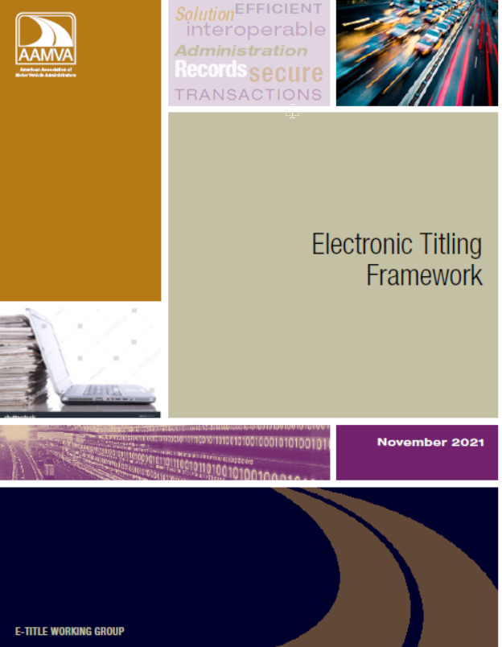
AAMVA E-Title Working Group
Electronic Titling Framework, published November 2021
Describes and outlines elements for electronic titling solutions
Promotes interoperability
Provides a model for identity management
Outlines stakeholder engagement
Surveys and Stakeholder Engagement
Public and private sector
Lessons learned from mortgage industry
Significance of information obtained

Slide 4
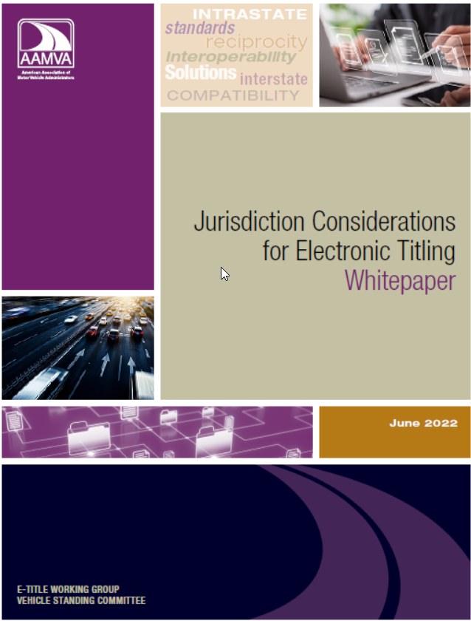
AAMVA E-Title Working Group
Jurisdiction Considerations for Electronic Titling Whitepaper - Published June 2022
15 topics, focused elements
Questions and resources for review &
assessment
Encourages priority in action in determining needs to build or enhance processes

Slide 5
E-Titling – All Elements of Title Transaction are Electronic

Slide 6
Next Steps - Jurisdictions
Capitalize on Working Group and Lessons Learned
Review current solutions – ELT, EVR, ERT
Identify – What works, gaps, resources needed
Technical specifications – functional needs and standards
STAKEHOLDER ENGAGEMENT IS KEY!!!

Slide 7
Next Steps - AAMVA
Consultant Approved by the AAMVA Board of Directors
Review all the stakeholder information the WG gathered
Assist jurisdictions to build intrastate solutions
Ensure interoperability with a vision for interstate
transactions
Solution is Vehicle Record Management – not just converting paper to digital format

Slide 8
What is Vehicle Record Management?
Obtaining, maintaining, viewing, and transferring information about a vehicle in a secure electronic format
Allow stakeholders, owners, and buyers access as appropriate
Identity management
Transition from vehicle titling, to vehicle record management
Many elements and processes
The lifecycle of a vehicle maintained in an electronic format

Slide 9
To be continued…

Slide 10
Contact Information
Marcy Coleman, Esq.
Manager, Vehicle Programs
American Association of Motor Vehicle Administrators (AAMVA)
mcoleman@aamva.org
C: 703.258.9705
4401 Wilson Blvd, Suite 700 | Arlington, VA 22203
Safe Drivers, Safe Vehicles, Secure Identities, Saving Lives!

Slide 11
Framing the Future: Electronic Title and Vehicle Records Management
National Association of Motor Vehicle Boards and Commissions
September 22, 2022
Nashville, TN

Slide 12
THANK YOU
Questions?

