Slide 1
EV’s and the Future of Dealer Laws: Facts, Plans, Perceptions, and What-Ifs Steve Yatvin Partner Barack Ferrazzano
September 22, 2022
Notes:
Opening point: I’m not here to predict – I’m here to identify the issues that will influence what the dealer laws look like in an EV-emerging world

Slide 2
“We always overestimate the change that will occur in the next two years and underestimate the change that will occur in the next ten. Don’t let yourself be lulled into inaction.”
– Bill Gates

Slide 3
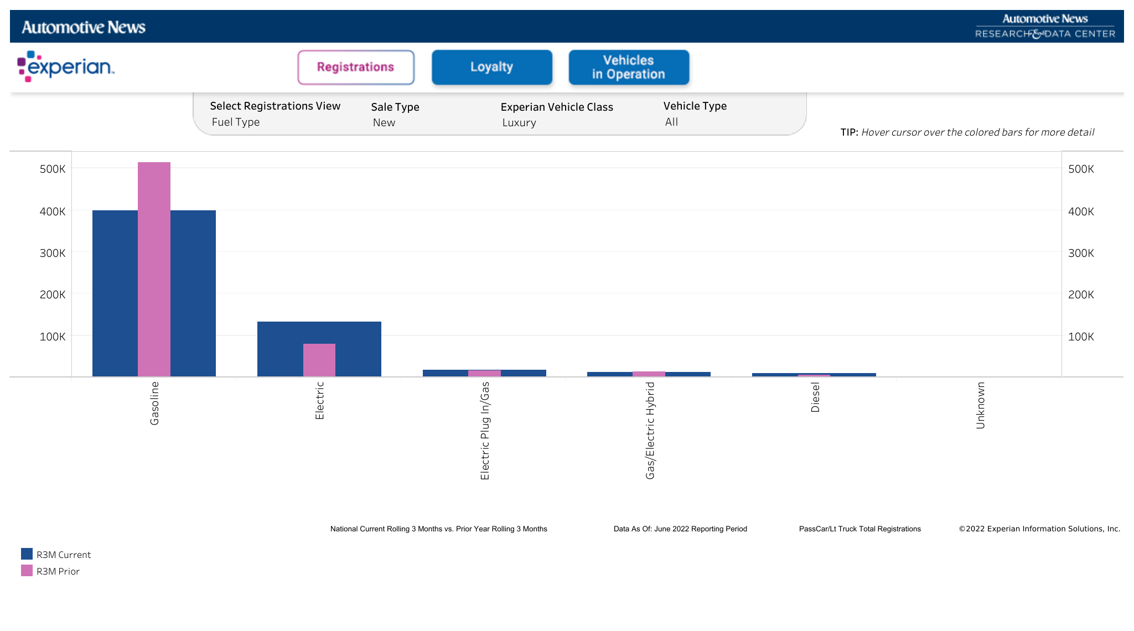
Facts
EV Adoption Has Increased Significantly in the Luxury Market

Slide 4
Facts
Luxury Growth Driven Almost Exclusively by Tesla
Now the #1 Selling Luxury Brand in the U.S.
52% YoY Growth July-June ’21 to July-June ’22 (+135,000 sales –256,000 to 391,800)

Slide 5
Facts
Luxury Incumbents Catching-Up on EV Development
Mercedes-Benz Launches EQ Lineup, Starts EQS-SUV Production
Genesis – GV60 – Brand’s First All-Electric Model
Jaguar Land Rover Launches Reimagine Strategy
Audi e-tron
Cadillac Lyriq
Notes:
MB EQS-SUV Being Assembled in Alabama

Slide 6
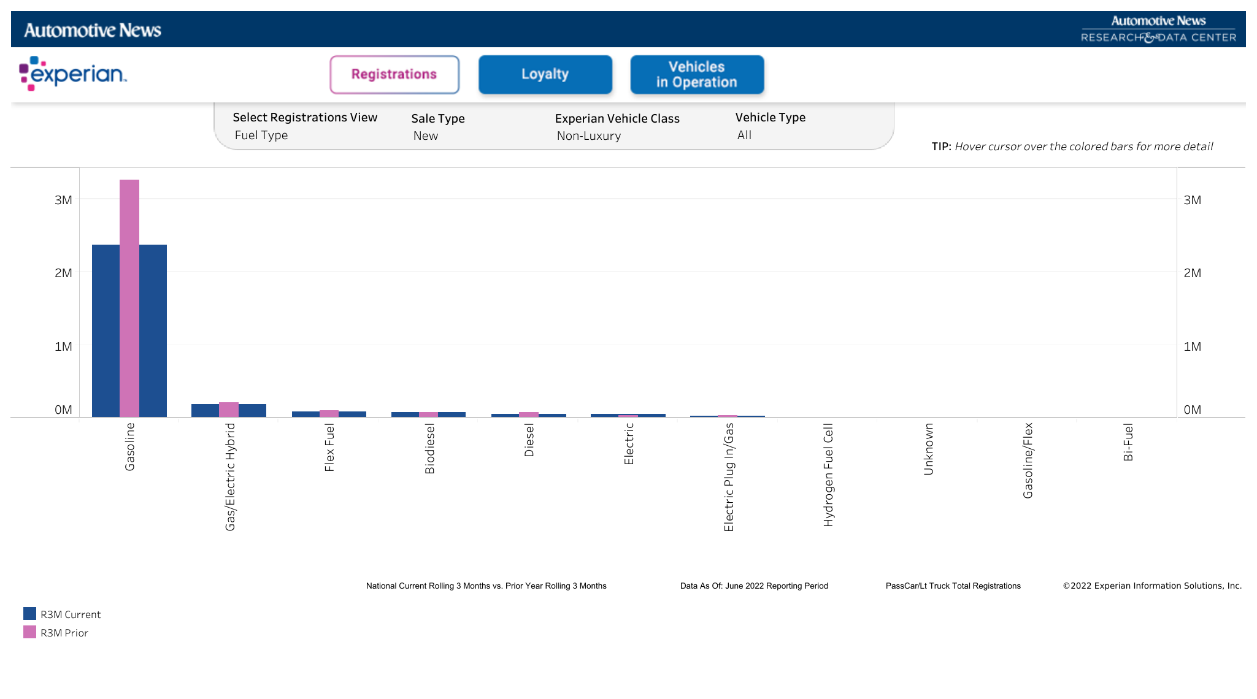
Facts
Volume Brands Have Seen Almost No EV Growth

Slide 7
Facts
Volume Line-Makes are Getting Into the EV Mix
Hyundai Ioniq 5 (Car and Driver’s 2022 EV of the Year)
Ioniq 6 Coming Next Year
Ford F-150 Lightning
Kia EV6
Volkswagen ID.4
Nissan Ariya
Subaru Solterra

Slide 8
Facts
New EV Brands Launch
Rivian: +3,600 (0 to 3,600 YoY July-June R12)
Polestar: +3,845 (470 to 4,315)
Lucid: +700 (0 to 700)
VinFast opens stores in California in July
Lordstown expects deliveries this year

Slide 9
Plans
OEM Electrification Plans
Too many to list, but they all go like this:
“[OEM] will be all electric by [2025, 2030, 2035]”

Slide 10
Plans
Ford Model E Initiative:
Will dealers invest in charging infrastructure?
Will dealers push back on sales model?
Will other incumbent OEMs follow Ford’s lead?

Slide 11
Plans
Buick Buyout Offer
Will more OEM’s offer buyouts?
Will dealers consolidate into fewer and larger dealer groups?
Notes:
Note: Chevy not buying out dealers – may be a luxury only initiative

Slide 12
Plans
Government Electrification Plans
Inflation Reduction Act – incentives for investment in U.S. and free trade partners
California EV Mandate – No new ICE vehicles by 2035
Will other states follow California?

Slide 13
Plans
EV Investment - U.S. and Free Trade Partners:
Hyundai and Kia – EV Factory in Georgia
Volkswagen and Mercedes – Mineral Deals in Canada
Bosch (South Carolina) and Toyota (North Carolina) Battery Plants

Slide 14
Plans
EV Investment - U.S. and Free Trade Partners:
Panasonic Battery Plant in Kansas, with Second Plant to Come (likely in Oklahoma)
Tesla Considers Diverting Battery Cell Production from Germany to U.S.
Gotion Reportedly Building EV Battery Plant in Michigan

Slide 15
Perceptions
New Brands Launch Without Dealer Networks
Tesla – premise was that dealers would favor ICE models
Lucid, Rivian – just following Tesla’s lead, or is perceived benefit of direct sales model a more hardened belief?
Notes:
Tesla, Rivian, Lucid, VinFast, Lordstown do not/will not use dealer networks

Slide 16
Perceptions
Meyer (Atlantic) and Denning (Bloomberg) Articles
Perception is that dealer model inhibits EV adoption
Who are Meyer and Denning’s “Constituencies”
Meyer writes about climate change
Denning covers energy and commodities
Notes:
Key point: new constituencies are interested in how EVs are sold. Not just a concern of dealers and manufacturers – concern of environmentalists, free trade supporters, and wall street (see next slide)

Slide 17
Perceptions
Morgan Stanley November 2021 Report
Downgraded Penske and Sonic
Two SAARs: Franchise and Direct-to-Consumer
As Direct-to-Consumer sales grow, Franchise sales decline
Notes:
Main point: business/investor perception that dealer model threatens incumbent OEMs, and in turn the dealer model itself. This is the information that EV investors see, and could make them interested in

Slide 18
Perceptions
Morgan Stanley November 2021 Report:
“We see the inability of legacy OEMs to control the consumer experience in a direct-to-consumer model as one of the biggest threats to legacy OEMs over time – even bigger than the threat of electrification itself.”
Notes:
Note Truist (Stephanie Moore) – counter. Main point: business/investor perception that dealer model threatens incumbent OEMs, and in turn the dealer model itself. This is the information that EV investors see, and could make them interested in a direct sales model

Slide 19
Perceptions
Benefits of the Dealer Network Model to OEMs:
Financing source for land and infrastructure
Expertise – all things being equal, dealers are more effective at sales, customer development, customer education, service outreach
Notes:
NADA response to Robinson and Denning – dealers better equipped to aid volume buyer in financing EV purchase

Slide 20
What-Ifs
What if significant investment continues, but EV sales do not increase at a “sufficient” pace?
What if another direct-selling EV startup is as successful as Tesla?
What if Ford Model E initiative fails?
Notes:
3 aspects of Model E – inventory, uniform price, infrastructure

Slide 21
What-Ifs
What if Morgan Stanley’s “Two SAARs” theory becomes conventional wisdom, and what if the direct sales SAAR grows at a much faster rate?
What if the new constituencies concerned about how vehicles are sold become more vocal?

Slide 22
Questions, Comments, Discussion?
Steve Yatvin
steve.yatvin@bfkn.com
(312) 629-5192

