Slide 1
Over-the-Air Updates and Franchise Legislation
Steve McKelvey - Nelson Mullins
Jack Snyder - Barack Ferrazzano
Chris Price -Toyota Motor North America
Bruce Anderson - Iowa Automobile Dealers Assn

Slide 2
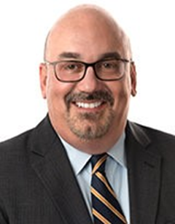
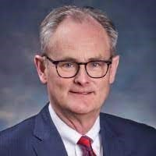
Steven A. McKelvey, Jr.
Nelson Mullins
Columbia, SC
(803) 255-9573
steve.mckelvey@nelsonmullins.com
Jack Snyder
Barrack Ferrazzano
Chicago, IL
312.629.5111
jack.snyder@bfkn.com
Christopher Price
Managing Counsel, Toyota Motor North America, Inc.
Plano, TX
christopher.price@toyota.com
Bruce Anderson
President, Iowa Automobile Dealers Assoc.
West Des Moines, IA
banderson@iada.com

Slide 3
Overview
Background on Over-the-Air Updates
Legal Landscape
Passed and Proposed Legislation
Future Considerations

Slide 4
Background on Over-the-Air Updates

Slide 5
What are Over-the-Air Updates?
Over-the-air updates (“OTAs”): Using wireless connectivity to send data or updates to vehicles.
Vehicles have become—and are continuing to become—increasingly electronic.
At the same time, vehicles are becoming more connected than ever.
Vehicle hardware requires tools and a technician to diagnose any problem and repair, alter, or upgrade the hardware.
Firmware/software, however, may be increasingly updated by downloading and installing a patch and/or reflashing the memory, which can happen automatically and remotely, as it does with computers and phones.

Slide 6
What are Over-the-Air Updates?
Connected vehicle software and OTA capabilities are wide-ranging:
Safety/Critical Function – automatic braking, adaptive cruise control, lane departure
Infotainment – navigation systems, multimedia options, user interface
Vehicle features – performance upgrades (horsepower, range, etc.) and optionality
Autonomous functionality – OTAs will be critical in maintaining and updating autonomous vehicles
Reminders and Dealership Visits – Apps can be programed to notes service needs and automatically schedule service appointments
Can be free (updates) or at a cost (upgrades). Charges for upgrades can be built in to the price of the vehicle, paid upfront, or paid on a recurring basis (subscription/service agreement).

Slide 7
What are Over-the-Air Updates?
Usage: Auto manufacturers have used OTA updates to send out non-critical software updates to vehicles (i.e., changes to navigation maps and radio/infotainment systems) for years. In 2012, Tesla started using OTA updates to update critical systems.
In general, critical updates (i.e., updates to safety-critical systems, such as steering, braking, and engine-control software) historically required a visit to the dealership with a trained technician performing the update.
In 2012, Tesla started updating critical systems over the air.
Future Impact: As more vehicles become equipped with wireless connectivity, OEMs will start using OTA to perform more updates, including updates to safety-critical systems, impacting the entire auto industry from engineering, to manufacturing, to suppliers, to dealers, and to consumers.

Slide 8
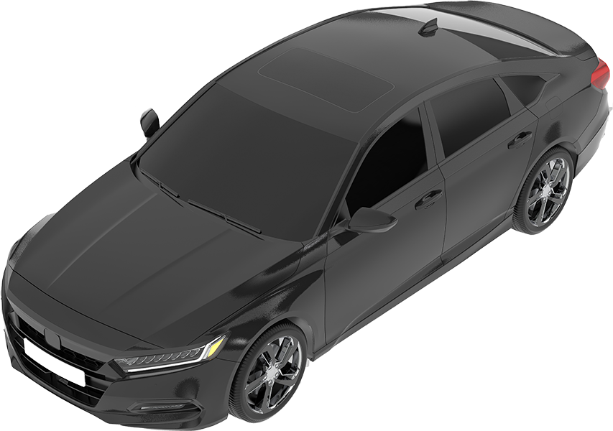
Benefits of OTAs
Safety, convenience, customer satisfaction, speed, cost savings, and optionality/functionality
RECALLS
UPDATES
FEATURES
More efficient
More comprehensive
Likely savings
Software updates
Safety and security
Release cycles
Customer satisfaction
New features
Extended product lifespan

Slide 9
Benefits of OTAs – Safety Convenience, Customer Satisfaction, and AVs
Safety/Critical Function - If an over-the-air update can resolve a safety issue, the instant, near-universal adoption provided by over-the-air update can dramatically enhance vehicle safety.
Convenience – Updates do not require a customer to schedule an appointment, visit a repair facility, or take any action beyond pushing a button to permit the update (if that, as updates can be automatic with customer consent).
Customer satisfaction – Updates ensure customers have the most current version of a particular application with the latest features.
Autonomous Vehicles – OTAs are a necessary component to the development and implementation of AVs.

Slide 10
Legal Landscape

Slide 11
Copyright, License Agreements, Consumer Litigation
OEMs are copyright owners - Vehicle-installed software/firmware are intellectual property protected in the United States by the Copyright Act. The holder of the copyright can control how this property is used and what is done with it through end user license agreements.
A copy of software can be sold, in which case it is treated as the functional equivalent to a sale of goods.
Alternatively, a copy of the software can be licensed, in which case the licensor can retain more control over the software.
Companies such as Apple, Tesla, and Porsche have either settled or are defending litigation of claims under the Computer Fraud and Abuse Act (CFAA) related to software updates.

Slide 12
Competing Concerns between OEMs and Dealers
OEMs desire efficiency and customer convenience. While dealers also desire efficiency and customer convenience, they also wish to maintain their involvement in the day-to-day servicing of all vehicles. Personal interaction with customers and vehicles is obviously vital to dealers’ business.
In addition to the practical concerns, there are potential legal implications related to the implementation of OTAs, including laws restricting warranty repairs, anti-competition statutes, and direct sales prohibitions.
OEMs and dealers must work together to maximize the potential of OTAs while maintaining positive and interactive relationships between dealers and customers.

Slide 13
NHTSA and State Regulators
NHTSA requires that automakers report all safety-related vehicle defects to owners, dealers, and NHTSA. Safety-related defects include safety-related software issues and updates.
No federal regulations currently prohibit modifications to vehicles via OTA updates.
But this does not mean NHTSA’s reporting and notification requirements can be bypassed.
CARB has previously indicated that “[m]anufacturers would be required to follow requirements of a standard recall program” when using OTAs for software recalls.

Slide 14
Legislation

Slide 15
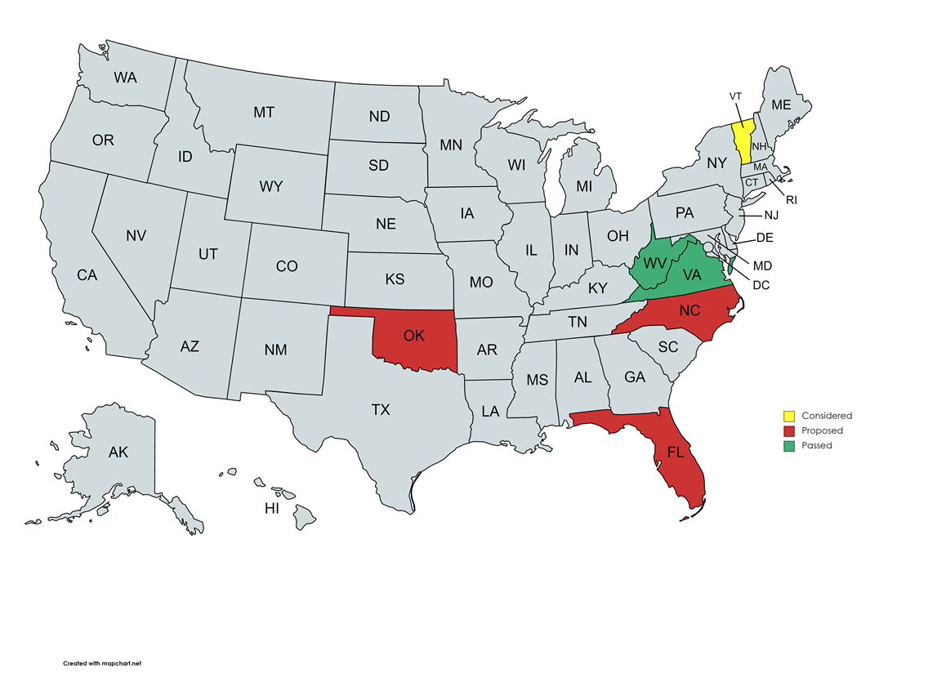
Passed and Proposed Legislation
A small but increasing number of states have proposed or passed legislation specifically pertaining to OTAs

Slide 16
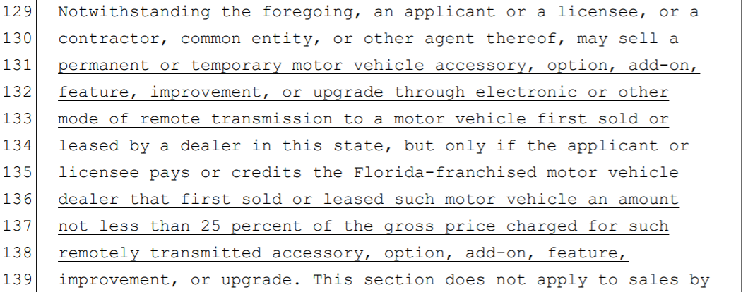
2021 Florida Senate Bill 1430 / House Bill 1065
Bill would have significantly limited over-the-air updates, imposing logistical challenges and requiring 25% payment to the selling dealer. (Did not pass.)

Slide 17
2021 North Carolina Senate Bill 631
Bill would prohibit a manufacturer from providing warranty service, or “updates at retail” performed physically, virtually, or digitally. (Did not pass.)

Slide 18
2022 Virginia House Bill 259 - PASSED
A prior proposed 2020 bill in Virginia would have expressly permitted OTAs. (Did not pass.)
The 2022 bill added language makes it unlawful for an OEM to fail to compensate a dealer for its assistance in an OTA.

Slide 19
2022 West Virginia and Oklahoma Bills
The original versions of these bills defined “dealer” broadly to include “the sale of parts, including the service of new and used motor vehicles, post-sale software and hardware upgrades or changes to vehicle function and features, and accessories for those motor vehicles.”
The only exception was for software upgrades to the navigation or entertainment systems.
Broad definition that arguably bans OTAs entirely.
WV passed a substantially revised version, and the OK bill did not pass.

Slide 20
2022 West Virginia House Bill 4560 - PASSED
Amended language requires an OEM to compensate a dealer for its assistance in an OTA.

Slide 21
Dealership Involvement in OTAs - - - - - - - - - - - - Perspectives on Telecommunications and Preemption

Slide 22
Evolution of Consumer Tech
Manual, time-consuming -> Automated, fast
Examples:
Toll gates on highways -> Open road tolling
Supermarket checkout -> self-checkout -> AmazonGo
Writing checks -> PayPal, ApplePay, GooglePay, etc.

Slide 23
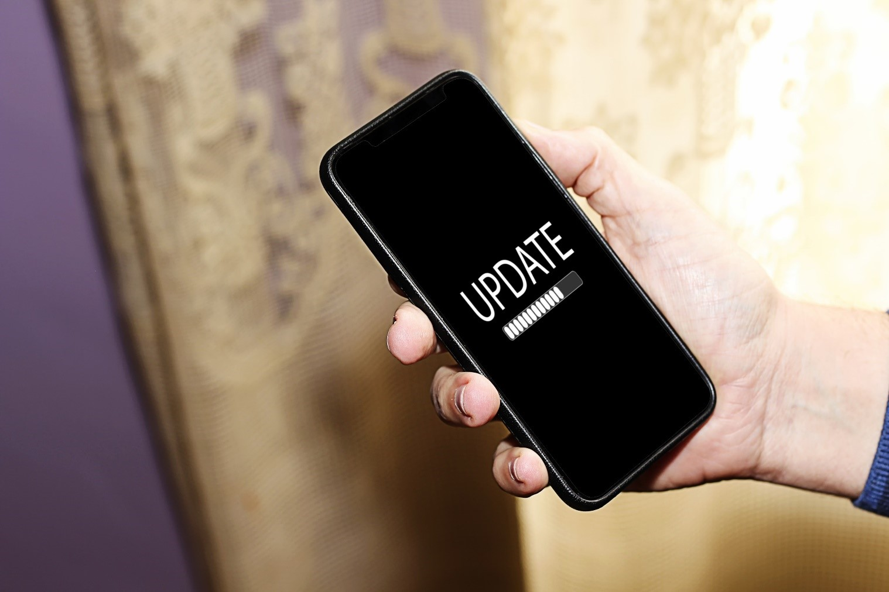
Intuitions about When to Require an Intermediary
Are OTA updates more like this?
Or this?

Slide 24
Intuitions about When to Require an Intermediary
Are OTA updates more like this?
Updating software on a computer or smartphone
Browsing a web site
Making a phone call
Streaming a TV show
Or this?
A doctor prescribing medicine
A driving instructor working with someone who has a learner’s permit
Going to law school for 3 years before practicing law
Compulsory auto insurance

Slide 25
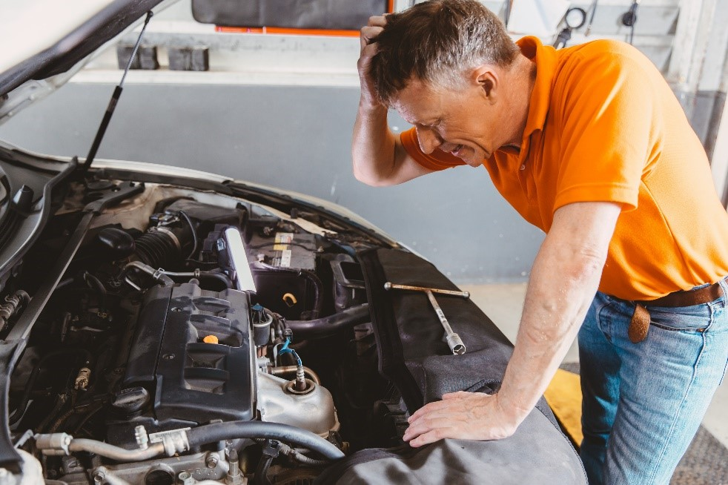
Intuitions about When to Require an Intermediary
Does a consumer that receives an OTA update encounter…
This level of difficulty?
Or this level of difficulty?

Slide 26
Physical Rules for How Devices Update?
Required to bring your TV or computer to the store for updates?
Required to bring your smartphone to the wireless store?
Only allowed to use or update medical app while at the hospital?
Where do OTA updates take place?

Slide 27
Physical Rules for Where Data Is Used?
Linking data use to location
Ebooks and libraries
Streaming movies at home / going to movie theater
Electronic retail / brick and mortar

Slide 28
Federal Interest – Communications Spectrum
Proposed rulemaking for allocation of spectrum for intelligent transportation systems. In the Matter of Use of the 5.850-5.925 GHz Band, FCC 20-164 (ET Docket No. 19-138):
“Given the significant advances that have been made in automotive connectivity using a variety of means in different spectrum bands outside of 5.9 GHz, an ever-greater portion of the overall valuable spectrum resource is being used to support automotive-related functions, including those related to safety.”
Could this, and should this, spectrum be used for OTA?

Slide 29
Federal Interest – Vehicle Safety
“Over-the-Air (OTA) software and firmware updates are widely considered essential for networked devices. In the automotive industry, OTA firmware updates are anticipated to increase the efficiency and decrease the time in updating the critical firmware in vehicles’ electronic control units[.]” NHTSA, Cybersecurity of Firmware Updates, DOT HS 812 807 (Oct. 2020).

Slide 30
Federal Interest – Preemption of State Law
47 U.S.C. § 332(c)(3)(A) (emphasis added):
[Subject to certain non-applicable exceptions,] no State or local government shall have any authority to regulate the entry of or the rates charged by any commercial mobile service or any private mobile service, except that this paragraph shall not prohibit a State from regulating the other terms and conditions of commercial mobile services.
Dealership software update rules, with related dealer reimbursement requirements, implicates entry or rates?
Can states tell Verizon, et al., where customers can use their networks to update their firmware on their vehicles?

Slide 31
Federal Interest – Preemption of State Law
Preemption in Practice – 5G Rollout
“The [FCC] has used preemption to facilitate the rapid deployment of 5G service. In two orders issued in 2018, the Commission preempted state and local moratoria on deploying telecommunications facilities and preempted certain requirements on deployment of small wireless facilities . . . . Specifically, the second of these orders preempted the charging of excessive fees and the imposition of unreasonable non-fee requirements, such as rules mandating that the small cell sites meet unreasonable aesthetic requirements. . . . In August 2020, the Ninth Circuit largely upheld these 2018 orders, vacating only the FCC’s standards on permissible aesthetic requirements.” Stepping In: The FCC’s Authority to Preempt State Laws Under the Communications Act, Congressional Research Service, No. R46736 (updated Sep. 2021)
Should the FCC issue a similar rule for OTAs? Does it need to?

Slide 32
Future Considerations

Slide 33
Potential Legal Developments
As the use of OTA for safety-critical updates becomes more prevalent, we may see:
NHTSA revise current safety regulations to expressly cover the use of OTA updates.
States enact statutes regulating the use of OTA updates and the roles OEMs and dealers in the process.
States enact consumer protection statutes protecting consumer information and rights related to the use of OTA updates.
States enact and revise current lemon law statutes to incorporate the use of OTA updates.
States enact or revise UCC provisions to cover the use of OTA updates.

Slide 34
Dealer Concerns
Customer Protection – Many dealers feel they need to be part of the OTA process to ensure updates are properly performed and customers are safe and satisfied.
OTAs can substantially increase recall completion rates and improve customer safety and satisfaction.
Money/Fairness – Many dealers are concerned they may be asked to sell base model vehicles, with consumers later paying manufacturers directly for unlocking options and upgrades.
This has not proven to be an attractive or successful business model. Customers do not want to buy OTA “add on” for all vehicle features. A better approach is likely to have dealers handle the sale of OTA products – similar to the offering of financial products

Slide 35
Collaborative Effort
Regardless of how OTAs develop in the coming years, a successful implementation of OTAs will require a collaborative effort between OEMs and dealers in order to provide customers with an optimal experience.
OEMs may have more direct-to-consumer interfacing in the context of OTAs, but dealers will remain an important and necessary component for the implementation of OTAs, just as they are with other manufacturer-consumer relationships (e.g., financing, service plans, subscription-based communications, in-vehicle security and emergency services, etc.).

Slide 36
Questions?

