Slide 1
Vehicle Subscription Services
Alisa Reinhardt, California New Car Dealers Association
Bert Rasmussen, Scali Rasmussen
Colin Buller, Mercedes-Benz USA
John Skelton, Seyfarth Shaw LLP
Anthony Bento, California New Car Dealers Association

Slide 2
MODERATED BY: PAULA J. SHAW
EXECUTIVE DIRECTOR
TENNESSEE MOTOR VEHICLE COMMISSION

Slide 3
VEHICLE SUBSCRIPTION PROGRAMS
OVERVIEW

Slide 4
VEHICLE SUBSCRIPTION PROGRAMS
WHAT ARE THEY?
Offered by individual automakers, dealers, and separate providers, vehicle subscription programs offer a new mobility option.
Vehicle subscriptions allow customers to make all-in, month-to-month payments, and give them the option to frequently switch vehicles for changing needs.

Slide 5
OEM PROGRAMS
WHAT’S OUT THERE?

Slide 6
MERCEDES-BENZ
COLLECTION
Multiple subscription tiers, start at at $1,095/month
Customers can frequently switch vehicles and have unlimited access to vehicles within their tier
Insurance, roadside assistance, and maintenance included
No mileage limitations

Slide 7
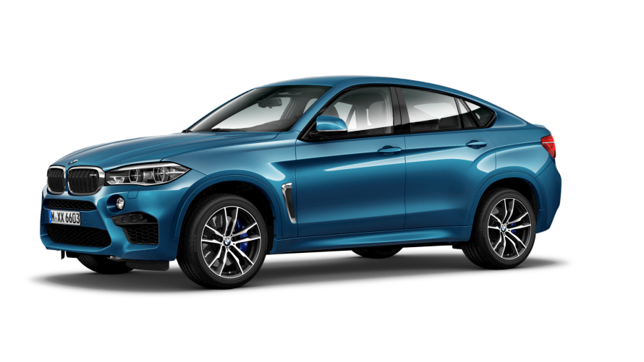
BMW
ACCESS
3 membership tiers: from $1,099/month to $2,699/month
$575 “joining cost”
No mileage limitations and unlimited switches between models
Insurance, roadside assistance, and maintenance included

Slide 8
VOLVO
CARE BY VOLVO
Starts at $650 per month
$500 deposit
Annual mileage limit of 15,000
Insurance, service, wear and tear, and roadside assistance included
Restricted to the XC40 and S60

Slide 9
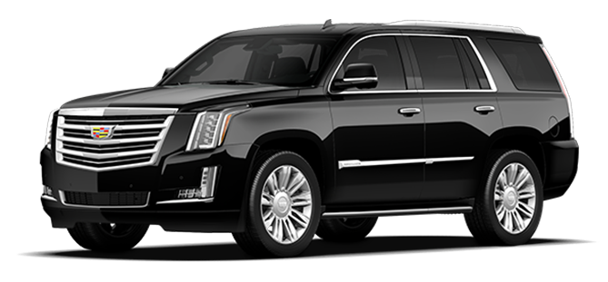
CADILLAC
BOOK
Flat monthly fee of $1,800
$500 initiation fee
2,000 mile/month limit
18 vehicle exchanges per year
Insurance, routine maintenance and repairs, vehicle registration costs, OnStar, Sirius XM, 4g LTE, and state and local taxes included

Slide 10
PORSCHE
PASSPORT
$2,000-3,000 per month
$500 activation fee
No mileage restrictions
Can change vehicles daily
Insurance, maintenance, hand-detailing, and taxes included

Slide 11
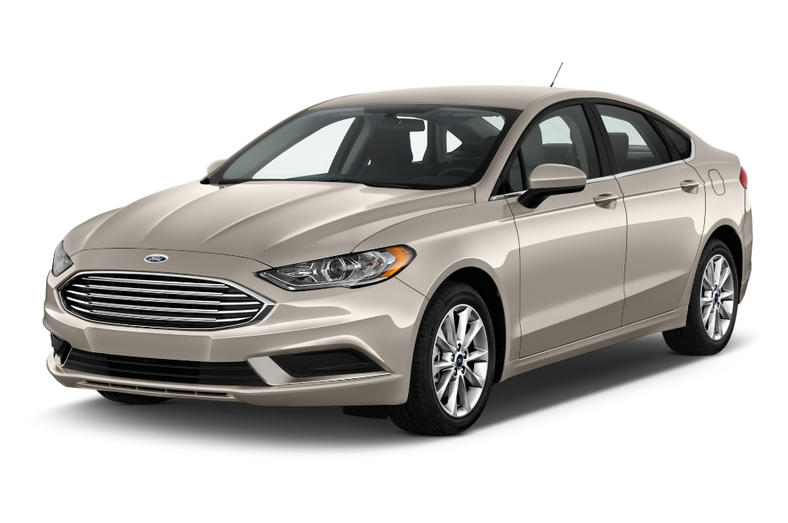
FORD & LINCOLN
CANVAS
Starts at $400/month
CPO vehicles
Mileage plan, with rollover
Customers can drive each vehicle for a month, and then can switch
Insurance, warranty coverage, maintenance, registration, and roadside assistance included

Slide 12
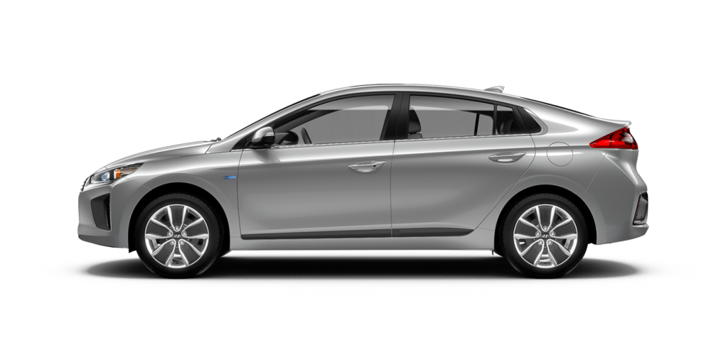
HYUNDAI
IONIQ UNLIMITED+
Starts at $295 per month
$2,500 due up front
Unlimited mileage
Vehicle charging reimbursement
36-month term
Initial taxes, title, license, and fees included

Slide 13
PRICING COMPARISONS
 | 3-year lease cost | 3-year subscription cost | Subscription premium
Cadillac Escalade | $48,932 | $65,300 | $16,368
BMW X6 M | $68,974 | $133,200 | $64,226
Mercedes-Benz SLC 300 | $35,031 | $39,915 | $4,884
Volvo XC40 | $25,489 | $23,900 | ($1,589)
Porsche 718 Boxster | $49,481 | $72,500 | $23,019
Source: Edmunds

Slide 14
OTHER PROGRAMS
WHAT’S OUT THERE?

Slide 15
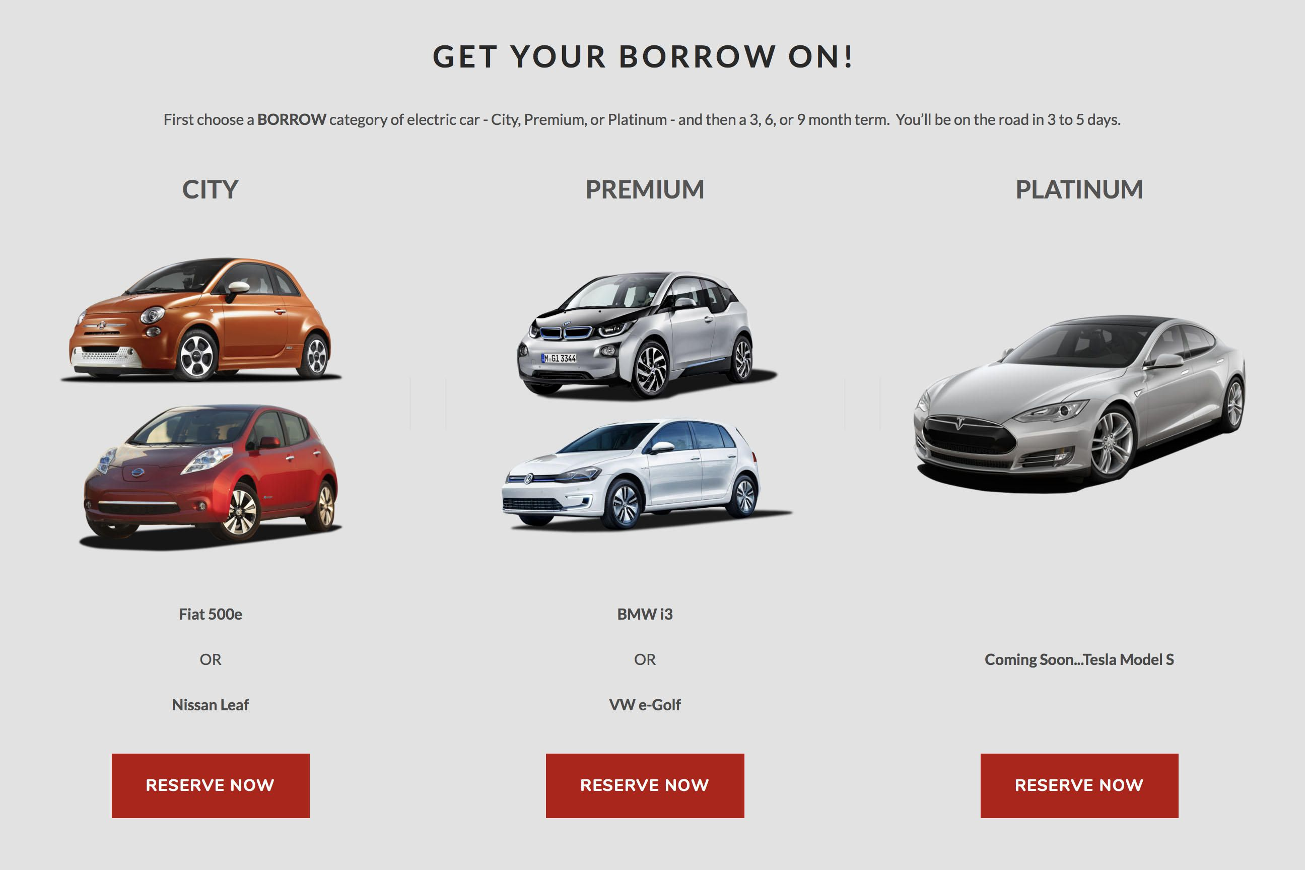
FAIR
One-time Start Payment per car, then monthly payment for as long as the customer keeps it
Over 30 different brands offered
Pre-owned and certified pre-owned cars
Less than 6 years old with fewer than 70,000 miles
Limited warranty, routine maintenance, and roadside assistance included

Slide 16
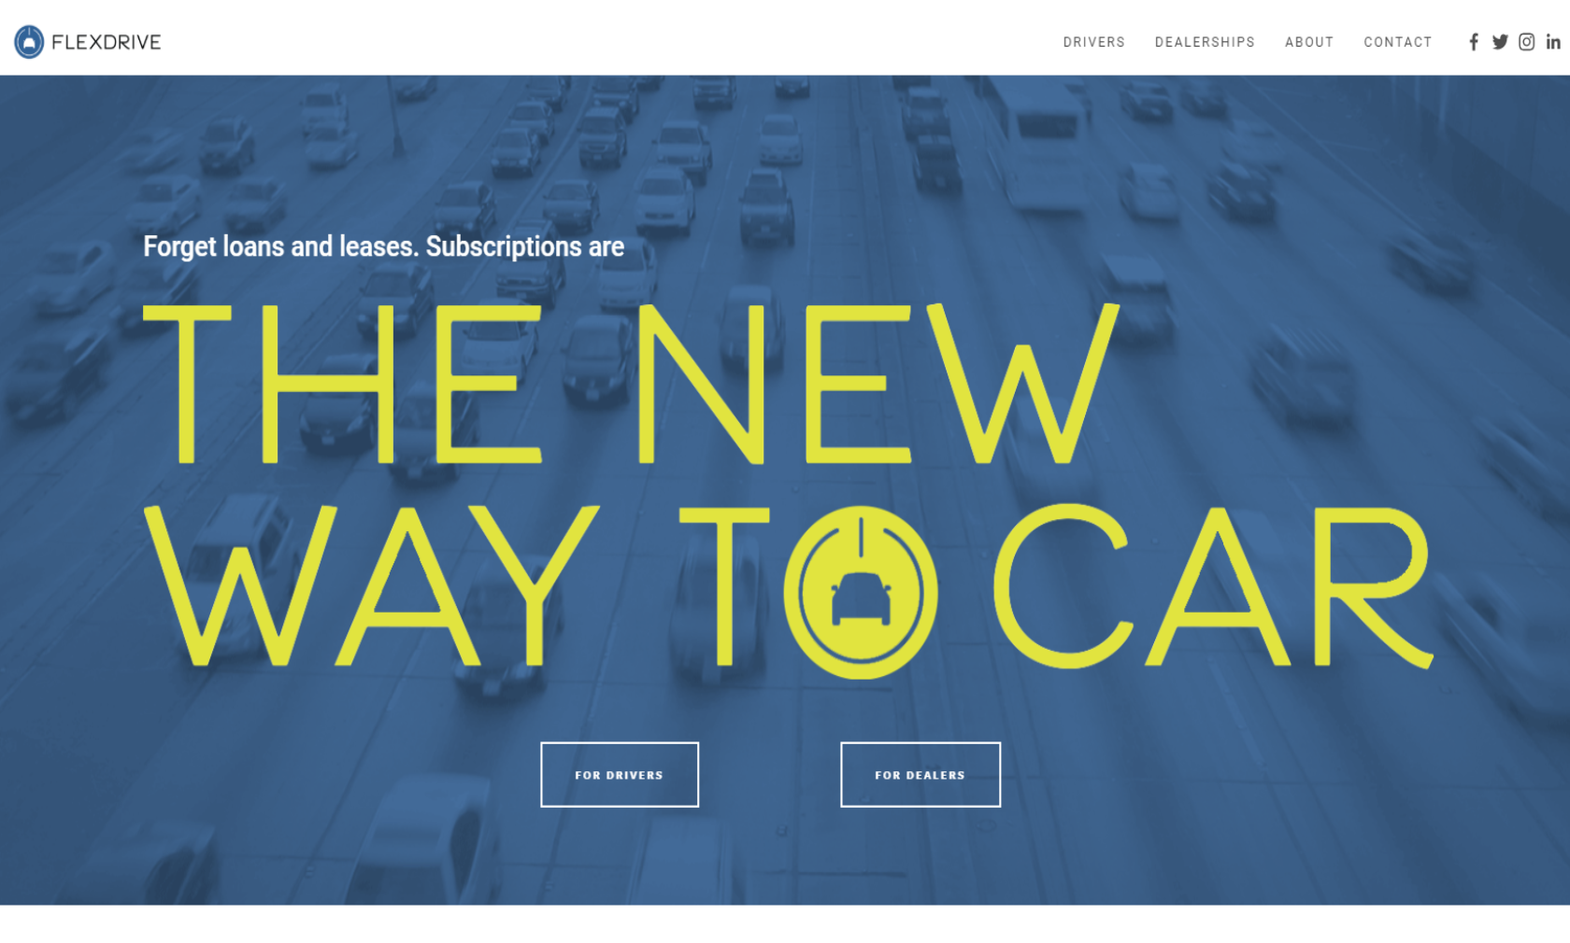
FLEXDRIVE
Flexdrive works with local authorized dealers, and those dealers determine weekly and monthly subscription fees for each vehicle they offer
Insurance, maintenance, and roadside assistance included
Customers can subscribe to a car for as little as 7 days or as long as 28 days at a time. Subscriptions can be renewed an unlimited number of times

Slide 17
CLUTCH
Clutch is a software platform that lets the automotive industry offer subscription services
Partners and customers are mostly dealer groups and OEMs
Several dealership groups and automakers have partnered with Atlanta-based Clutch, including Mercedes, Porsche and BMW

Slide 18
DATA TRENDS
COX AUTOMOTIVE SURVEY
1/4 of consumers surveyed said they are aware of vehicle subscription services offered by automakers and dealer groups
Subscription services are most appealing to young males and new-vehicle buyers
1/10 of consumers asked said they would be open to a subscription service instead of purchasing or leasing a vehicle

Slide 19
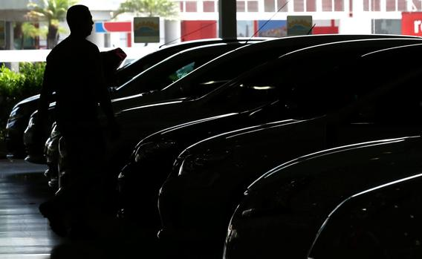
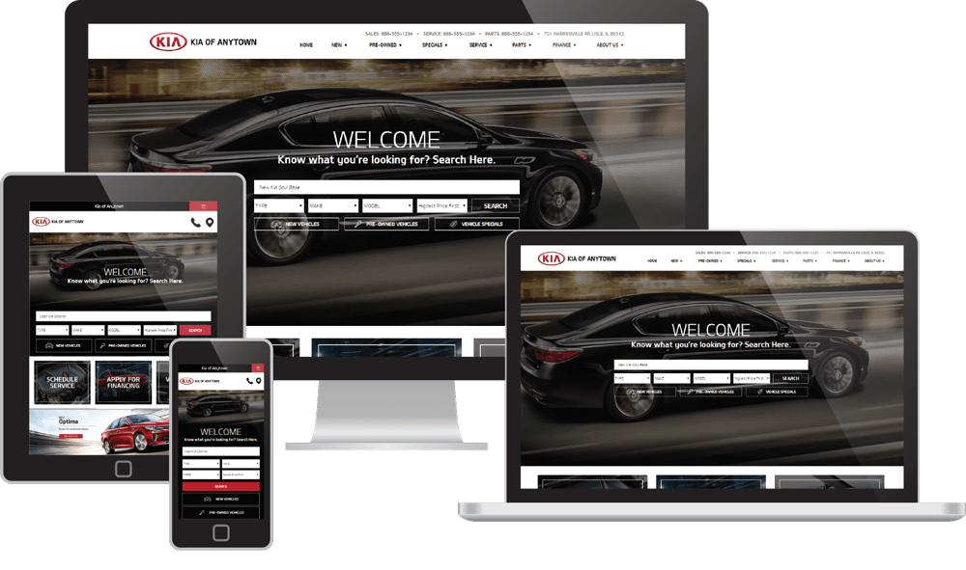
AUTO NEWS
SUMS IT UP
“Dealers want to make sure they're not left out of a new business stream and that their margins are protected for the long run, while automakers want to be able to offer mobility services and advanced technology to consumers absent new and complicated statutes and regulation. The differences in opinion could lead many states in the next few years to review how subscription programs are handled.”

Slide 20
CREATING SUBSCRIPTION PROGRAMS

Slide 21
OEM SUBSCRIPTION PROGRAMS – Case Study
IMPLEMENTATION

Slide 22
MERCEDES-BENZ
To avoid even the appearance of anticompetitive conduct, absent approval from your legal department, you should avoid discussions with competitors regarding:
Prices;
Production or supply levels;
Allocation of customers, markets or territories; or
Joint refusals to do business with others.
Plaintiffs’ lawyers seek to portray discussions about other business topics between competitors as anticompetitive. Thus, absent approval from your legal department, you should also avoid discussions with employees of competitors about other business topics including (1) customers, (2) terms of sale, (3) procurement, (4) product technology, and (5) market conditions.
If in doubt, please consult your legal department.
Attendees should stick to the approved agenda and ensure other attendees do the same. Be careful to avoid improper topics in side discussions. You should speak up if the meeting or a side discussion moves into inappropriate topics, and if necessary leave the meeting and alert your legal department.
COLLECTION
MBUSA Antitrust Guideline Statement:
Mercedes-Benz USA, LLC and the NAMVBC are committed to complying with competition laws. It is vital that this meeting be conducted in a manner consistent with such laws.

Slide 23
http://collection.mbusa.com/
Pilot program launched June 2018: Nashville TN and Philadelphia PA
Joint initiative between Mercedes-Benz USA LLC and Mercedes-Benz Financial Services USA LLC
Mercedes-Benz Subscription Services USA formed as a separate LLC
Core operations supported by local Mercedes-Benz dealerships
Multiple subscription tiers offered in each location
Monthly subscription fee includes access to a fleet of new Mercedes-Benz vehicles, a Collection Concierge who performs vehicle “flips”, insurance, maintenance, 24/7 Roadside assistance, plus registration and titling completed on each vehicle
Entire experience is managed through smartphone applications

Slide 24
What Worked Well:
Dealer input, involvement and support
Sales tax compliance – obtaining sales tax licenses, how to assess and remit tax to each state
Support from the executive directors at TN DMV & Dept. of Commerce
Provided guidance to local county DMV offices and to our dealers in Nashville
Challenges Encountered:
Multiple discussions with various state entities required:
Significant education and explanation required on what Mercedes-Benz Collection is…and how it differs from Daily Rental or other brands subscription offerings
Unlike daily rental, finance, or retail lease, there’s no “check box” for subscription programs on DMV title/reg application
Varying or conflicting guidance from local DMV offices – which our dealers rely on
State tax regulations are clear re: sales and use tax….but they need to be clearly communicated to the DMV teams as well

Slide 25
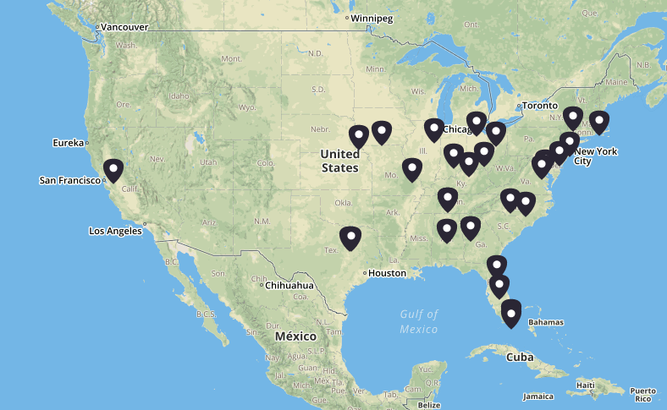
Subscriber Landscape – multiple programs live!
……..There is growing consumer demand for subscription services
Powered by Clutch Technologies

Slide 26
REGULATORY AND STATE LAW COMPLIANCE ISSUES
REGISTRATION & TITLE
TAXES
FRANCHISE LAWS
CONSUMER AND BUSINESS PROTECTIONS

Slide 27
Regulatory & State Law Issues -- Overview
Regulatory Issues
What is a vehicle subscription program (lease, daily rental, “other”)?
Titling and registering the subscription “fleet.”
How are subscription services “taxed”?
Insurance and protection from vicarious liability.
Because programs vary, need to work with local regulators.
OEM Programs - State Franchise Laws and Consumer/Business Protections
Current Laws addressing Subscription Services
Potential implications given existing state franchise laws
How do we apply existing consumer and business protections?
Should OEM subscription vehicle programs be regulated? Why/why not?

Slide 28
Regulatory-Related Issues
How to characterize a vehicle subscription services program?
Challenges of applying existing law/regulations to emerging technologies.
Subscription services programs reflect another variation of emerging technologies transportation alternatives (ride sharing, “zip car,” autonomous vehicles, etc.).
Is it a sale, a lease, a daily rental, or “other”?
Assembling the Fleet of Subscription Vehicles.
Titling and registration issues/logistics.
OEM vs. Dealer vs. Third Party programs

Slide 29
Regulatory-Related Issues, Cont.
When and how are subscription vehicles taxed?
Is the transfer to the subscription fleet a taxable “sale”?
What if subscription vehicles transferred and held for eventual resale?
Are taxes required to be paid/collected as part of Subscription fee?
Insurance and Vicarious Liability.
State minimum financial responsibility requirements
Are subscription fleet owners protected the same as rental car companies?
Graves Amendment (49 U.S.C. § 30106) - no vicarious liability for owner who “rents” or “leases” vehicle to another.

Slide 30
State Franchise Laws
Current laws specifically addressing Vehicle Subscription Services.
Indiana (House Bill 1195)
Defines VSS as -- allowing person exclusive use of vehicle for a recurring fee and limited period of time.
Excludes short-term vehicle sharing
All VSS prohibited until May 2019 – urges study.
California (Assembly Bill 2107 [2018] – not in final version of bill)
Sought to add vehicle subscription service to list of prohibited competition by OEMs.
OEMs and CNCDA agreed to meet in the coming months to discuss the issue.
New Jersey
Dealers are lobbying for subscription program vehicles to be classified differently for registration purposes, though no bill has been introduced. A bill could be introduced in the fall.

Slide 31
State Franchise Laws, cont’d
Implications given existing state franchise laws.
Implications for Dealer / OEM / Third Party programs?
Does an OEM vehicle Subscription Program “compete” with dealers? (How / why)

Slide 32
USA Today Subscription Discussion
“There’s also the hurdles that come with complex state-by-state dealership regulations, which can deny manufacturers the opportunity to sell their cars directly to consumers.”
“A big stumbling block for any car company is retail, but if you have a subscription model all those (dealer) franchise laws go away,” Brauer says. “A generation has grown up paying a monthly fee for cellphones, internet, streaming movies.”
- Karl Brauer, Executive Publisher at Cox Automotive

Slide 33
Dealer Concerns
Implications of existing state franchise laws.
Franchise modification
Example
New York – A franchise “‘modification’ means any change or replacement of any franchise if such change or replacement may substantially and adversely affect the new motor vehicle dealer’s rights, obligations, investment or return on investment.” (NY CLS Veh & Tr § 463)
Issues
Does the launch of a vehicle subscription program constitute a modification of a franchise agreement?
Must a manufacturer provide a notice of franchise modification prior to launching a vehicle subscription program?
Does a dealer have the right to challenge its required participation in a subscription program?

Slide 34
Dealer Concerns, cont.
Implications of existing state franchise laws.
Unlawful competition
Example
Arizona – Prohibits factories from directly or indirectly competing with their dealers. Competition includes the factory “selling, leasing or providing, or offering to sell, lease or provide, a vehicle or product, service or financing to any retail customer or lead.” Exceptions include products offered through dealers. (ARS 28-4460)
Issues
Is an OEM “competing” with a dealer if it directly contracts with a customer for the provision of a vehicle?
Is an OEM “competing” with a dealer if an OEM directly leases vehicles to customers, and the dealer acts as the delivery agent?
Is an OEM “competing” with a dealer if the subscription program shifts customers away from dealer-offered leases?
Is an OEM “competing” with a dealer if the dealer operates its own subscription program?

Slide 35
Dealer Concerns, cont’d
Consumer protections
Payment Packing
Including insurance (and other items) in monthly vehicle payments may violate state law (e.g., Cal. VC 11713.19).
Including insurance in monthly vehicle payments may create disclosure issues related to value of the vehicle at lease/subscription inception.
Persons that are less expensive to insure pay more for a vehicle.
Consumer Disclosure Issues
Are vehicle rental disclosures required?
Are vehicle lease disclosures required?
False and misleading characterizations of subscription program
Vehicles may be legally “used”
Business protections
Unfair practices law
Implied covenant of good faith and fair dealing
Economic torts

Slide 36
Dealer Concerns, cont’d
Hypothetical – BM Subscription Program
Bento Motors is launching the BM Vehicle Subscription Program. Key elements of the program:
BM’s leasing company directly contracts with customers for a two year subscription term.
Subscription includes “free” insurance and maintenance.
Customers have option to trade-up their vehicle after one year if they sign a new two year agreement.
New vehicles are delivered to customers at BM dealerships.
Program is offered to customers at $600 per month with “no money down.”
Comparable leases are $400 per month, with $3,000 cash due at signing. Insurance and maintenance not included.

Slide 37
Dealer Concerns, cont’d
Hypothetical – BM Subscription Program
When a vehicle is retailed through the BM Subscription Program, the vehicle should be regulated as a:
Rental.
Lease.
Subscription, which is not addressed by law, so BM can launch the program without it being regulated under current state law.
Subscription, which is not addressed by law, so BM should not launch the program until it receives a green light from state regulators.
None of the above.

Slide 38
Dealer Concerns, cont’d
Hypothetical – BM Subscription Program
What franchise laws are implicated by the BM Subscription Program?
Illegal competition, because the program is operatively a lease and it competes with the dealer’s existing lease offerings.
Franchise modification, because the program alters dealer obligations and it may materially affect dealer sales and lease expectations.
Both A and B.
None of the above, because vehicle subscriptions are not addressed by the BM franchise agreements and because BM is using its dealers to deliver the vehicles so it is not competing with them.

Slide 39
Other Considerations
Purpose of state laws – protect consumers/public welfare.
Regulations need to protect consumer options / choice.
With dealers, OEMs and third parties all offering subscription services -- regulate what is offered, not who is offering.
Role of dealers (operational support, etc) likely out of necessity.

Slide 40
Closing thoughts on the role of franchise law in vehicle subscription services.
Can subscription programs fit within the existing framework of state franchise laws?
Can subscription programs fit within existing consumer and business protection laws?
Do franchise laws make sense in context of vehicle subscriptions?

Slide 41
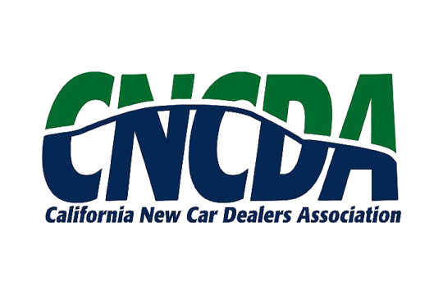
John R. Skelton
Co-Chair, Franchise & Distribution Counseling and Litigation Group
Seyfarth Shaw
jskelton@seyfarth.com
617-946-4847
Anthony Bento
Director of Legal Affairs
California New Car Dealers Association
abento@cncda.org
916-441-2599
Colin Buller
Business Transformation Dept. Lead, Strategic Retail Development
Mercedes-Benz USA
Colin.Buller@mbusa.com
770.705.2012
Bert Rasmussen
Partner
Scali Rasmussen
hrasmussen@scalilaw.com
213-239-5622
Alisa Reinhardt
Director of Regulatory Affairs
California New Car Dealers Association
areinhardt@cncda.org
916-441-2599
Paula Shaw
Executive Director
Tennessee Motor Vehicle Commission
Paula.J.Shaw@tn.gov

