Slide 1
Framing the Future: Wholesale Dealer Licenses
National Association of Motor Vehicle Boards and Commissions
September 23, 2022
Nashville, TN

Slide 2
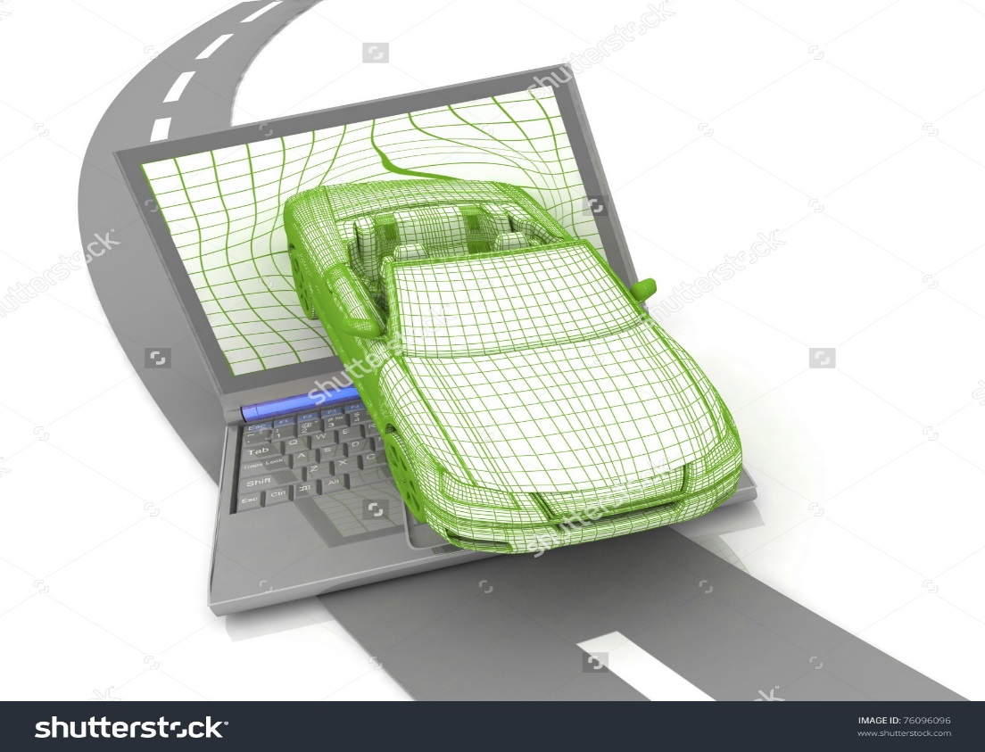
Start of the Project
Internet Vehicle Sales
Working Group

Slide 3
Background
Internet vehicle sales offer the ability for licensed motor vehicle dealers to expand their businesses and save money previously spent on other types of advertising.
May ease the buying process and expand the choices for buyers and sellers, the internet can also be a conduit for fraudulent activity.

Slide 4
Purpose of Working Group
A majority of states do not regulate motor vehicle internet sales but would like to have guidance in this area.
Therefore the working group will develop best practices for the regulation of internet vehicle sales.
The best practices will provide recommendations, tools, and educational materials to member jurisdictions to identify, understand and combat fraud and deceptive internet vehicle sales practices.
The working group will also identify issues and develop guidance for jurisdictions to address concerns arising from wholesale dealer licensing.

Slide 5
Membership
Eleven members representing the following disciplines with a balance of members from all four AAMVA regions:
Dealer licensing and/or have managerial oversight of motor vehicle dealer licensing.
Title issuance process and/or have managerial oversight of said process.
Legal and/or policy area expertise.
Law enforcement officer or investigator with vehicle fraud investigation expertise.

Slide 6
Members
Jennifer Berry, Chair (CA)
William Harbeson, Vice-chair (TX)
David Silk (ME)
James Walker (NJ)
Ted E. Smith (KS)
Michael Athey (IA)
Teri Baltisberger (NV)
William Childress (VA)
Jeff DeVere (WA)
Larry Purdy (OR)
Monica Weischedel (SD)
Cathie Curtis (AAMVA) Project Manager
Paul Steier (AAMVA)

Slide 7
Timeline
2017 Establish Working Group, hold conference calls and two in-person meetings, identify issues, work with industry stakeholders, begin to research solutions
2018 Continue to research solutions and draft best practices, continue to meet via conference calls and hold two more in-person meetings
Early 2019 Finalize best practices and publish

Slide 8
Wholesale Licensing
Working Group also looked at the unique issues related to wholesale dealer licensing and may also develop some best practices
It is problematic in some states and not in other states.
There are some fraudulent activates being discovered in some states.
Some are selling vehicles directly to the pubic.
Licensed in one state but doing business in another state.

Slide 9
Problems Reported
Working Group noted several concerns from various jurisdictions regarding wholesale dealers.
Selling outside the terms of the license. Selling to the public.
Lending or Reselling Wholesale Licenses
Curbstoning
Failure to Meet License Location Requirements

Slide 10
Wholesale License Requirements
Working Group noted some common requirements for wholesale dealer licenses.
Surety Bond
Posted Hours
Established Place of Business – Often Abused
Display Area
Records Availability
Sales Restrictions on Signage

Slide 11
Wholesale License Whitepaper
The Internet Sales Working Group developed a Whitepaper in December 2019.
Outlined the Problems
Included Case Studies
Developed a list of possible solutions to the reported challenges.

Slide 12
Wholesale License Whitepaper
Proposed Solutions
Review regulations to ensure they address current business practices and models.
Limit the number of wholesale dealers allowed in one physical location.
Licensed wholesale dealers should be required to occupy their location and to be available at the location during their posted hours.
Records of all transactions should be maintained at the location either in hard copy or electronic form.
Dealer records should be required to be produced to officials within a specified timeframe.

Slide 13
Wholesale License Whitepaper
Proposed Solutions
Wholesale dealers should not be authorized to obtain and issue temporary registrations and tags.
Wholesale dealers should not be authorized to process title and registration transactions for retail sales.
Business signs should be required to contain the name as it appears on the wholesale license and any other name used to do business, and signage should be required to include verbiage similar to “sales restricted to wholesale or dealers only,” or “purchasers must be licensed dealers.”

Slide 14
Wholesale License Whitepaper
Proposed Solutions
Educate consumers on the risks of buying vehicles online and out of jurisdiction, on how to file a complaint with jurisdictional officials, and how to refer suspected curbstoners to the appropriate authorities.
Seek authority to tow curbstoned vehicles when discovered.
Laws should include appropriate administrative actions, civil, or criminal penalties.
Share information on cases of fraud with other jurisdictions to help prevent bad actors from moving to other jurisdictions and engaging in the same fraudulent activities.

Slide 15
Wholesale License Whitepaper
Proposed Solutions
Inventory databases can support jurisdictional oversight. Requiring dealers to log their vehicle inventory and title reassignments into a database using a real-time process, allows regulators and taxation authorities to monitor and audit the movement of vehicles and other dealer activity.
The reselling of wholesale dealer licenses should not be allowed.
Have sufficient, well-trained investigators with enforcement authority to monitor wholesale dealer license activity.

Slide 16
Contact Information
Marcy Coleman, Esq.
Manager, Vehicle Programs
American Association of Motor Vehicle Administrators (AAMVA)
mcoleman@aamva.org
C: 703.258.9705
4401 Wilson Blvd, Suite 700 | Arlington, VA 22203
Safe Drivers, Safe Vehicles, Secure Identities, Saving Lives!

