Slide 1

Conditional Incentive Programs
National Association of
Motor Vehicle Boards & Commissions
2018 Fall Workshop
Joseph Roesner
The Fontana Group, Inc.
Todd Milbury
NADA
Randall Oyler
Quarles and Brady LLP
September 21, 2018

Slide 2
Disclaimers
  Overall goal is to describe current state-of-play
  Personal views
  Only talking about publicly available information
  Not all panelists may agree with the others' statements and slides!

Slide 3
Conditional Margin Programs

Slide 4
Picking up from our discussion last year . . .
  Last Year: Stair-Step Incentive Programs
    What are they? Bonus programs that allow dealers to earn escalating bonuses for achieving escalating sales targets
    Positive Story: Dealer reimbursement for sales costs; Consumer competition; Alignment of interests
    Negative Story: Different dealer pricing; Negative dealer impact; Cannibalization, not competition
  This Year: Conditional Incentive Programs
    What are they? Bonus programs that allow dealers to earn bonuses based on satisfying certain manufacturer standards

Slide 5
Conditional Incentive Programs
  Often Margin-Based: Achievement of standard equals a payment of x% of MSRP on retail sale of vehicle
  Relevant Concepts
    Trading Margin = MSRP less Invoice (a theoretical margin)
    Holdback = Percentage of MSRP; not shown on invoice
    Conditional Margin = Performance-based payments, typically a percentage of MSRP

Slide 6
Hypothetical Example
  $50,000 MSRP:
    7% Trading Margin = $3,500 ($50,000 MSRP / $46,500 wholesale)
      Amount to dealer varies, depending on actual retail sales price
    1% Holdback = $500
      Amount to dealer 1% automatic ($500)
    5% Conditional Margin = $2,500
      Amount to dealer varies from 0% to 5% ($0 to $2,500), depending on dealer satisfaction of standards

Slide 7
What Are the "Conditions"?
  Standards vary from manufacturer to manufacturer
  Some standards may be "qualifying" or "paying"
      Qualifying: Must achieve in order to be eligible for payment on "paying" standards
      Paying: Achievement results in bonus payment

Slide 8
New Vehicle Sales Volume
Sales vs. Objectives
Objectives may be based on:
  Benchmark
  Prior Period Sales
  Hybrid of above
Payment may be tiered (stair-step)

Slide 9
Brand Standards Examples
These can be independently assessed or on an all or nothing basis.
  Facility Compliance
  People (Position and/or number)
  Training (this is commonly independent)
  Brand Development (BDC, Dress Code, etc.)
  Web-site (factory site)
  Customer (service loaners, roadside assistance)

Slide 10
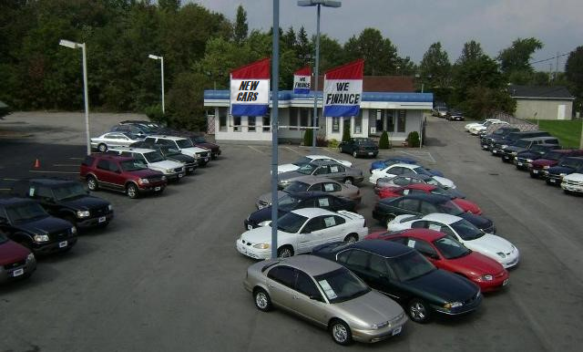

Slide 11
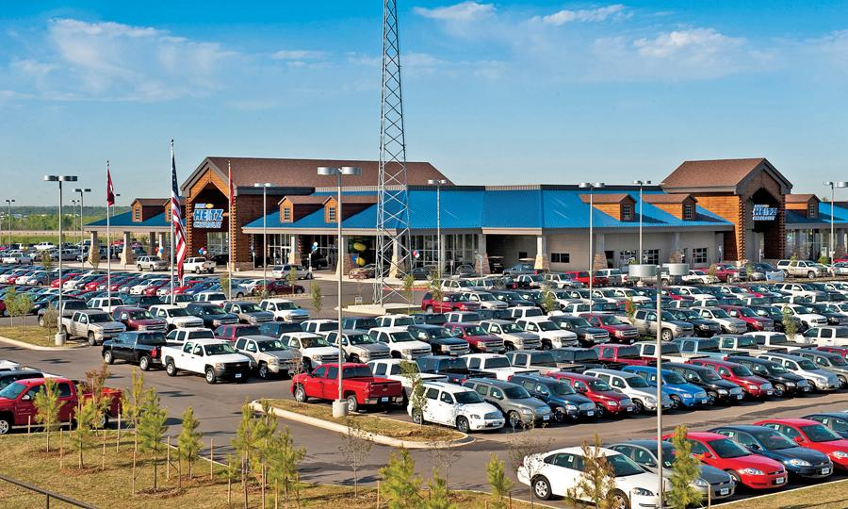

Slide 12
Brand Standards Program Example
 | Planning Volume | Incentive | Paid on Sale of $50,000 vehicle
Tier 5 | None | 1.0% | $500
Tier 4 | <100 | 0.2% | $100
Tier 3 | 100-399 | 1.25% | $625
Tier 2 | 400-699 | 2.0% | $1,000
Tier 1 | >700 | 3.0% | $1,500

Slide 13
Customer Satisfaction Index
Sales Satisfaction Survey
Service Satisfaction Survey
Can be independently assessed or combined
Typically “Average Based” and “Top-Box”
Can be tiered

Slide 14
Top Box
10………………………………………………………………………………………………….…………1
Completely Satisfied Not at all Satisfied
10………………………………………………………………………………………………….….………1
Truly Exceptional Unacceptable
5……………………………………………………………………………..………………………….……1
Extremely Likely to Recommend Extremely Unlikely to Recommend
5……………………………………………………………………………..………………………….……1
Definitely Would Definitely Would Not

Slide 15
Off-Lease Purchase
Paid on New vehicle sales
  Objectives based on purchase of off lease vehicles:
  Percentage of lease returns or
  Percentage of prior year new vehicle sales/leases

Slide 16
Certified Pre-Owned
Can be combined with off lease based bonus
Can be tiered
Objectives typically based on new vehicle sales
Cost to dealer to certify vehicle as CPO

Slide 17
Marketing
Funds contributed with participation in a Local Advertising and Marketing Program and/or other Factory marketing program

Slide 18
In-Territory Sales
Certain percentage of retail sales must be within:
  Factory assigned Dealer Area and/or contiguous Dealer Area
  Designated Market Area (“DMA”)
  Within certain mileage from dealership

Slide 19
Sales Loyalty
Percentage of Brand owners purchasing another vehicle that purchased from particular dealership
Targets can be adjusted based on averages grouped by size and geographic region

Slide 20
Service Sales related to Units in Operation
Customer Pay hours or vehicles serviced relative to size of market measured by Units in Operation (UIOs)
Objectives set on averages
Can be adjusted based on number of same brand dealerships selling into the market

Slide 21
Elite or VIP bonus
Dealerships eligible for and achieving all bonuses are paid all or some portion of unearned funds that otherwise would have been paid to dealerships that did not achieve performance requirements.

Slide 22

Stair-Step Incentive Dealer Survey

Slide 23
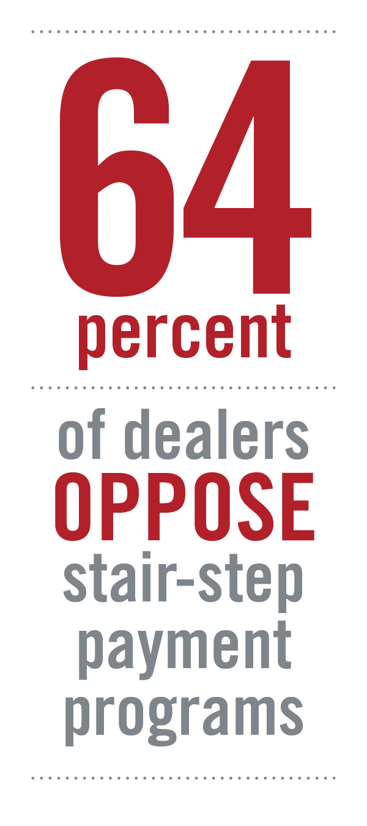
Late 2015: Summary of Findings
64% of dealers oppose stair-step payments programs
Dealers of all sizes feel that the programs hurt credibility with consumers
Recommendations shared with each OEM
  Fair and Reasonable
  Achievable (for both large and small dealers)
  Consideration given to products included and available inventory
  Less complex

Slide 24
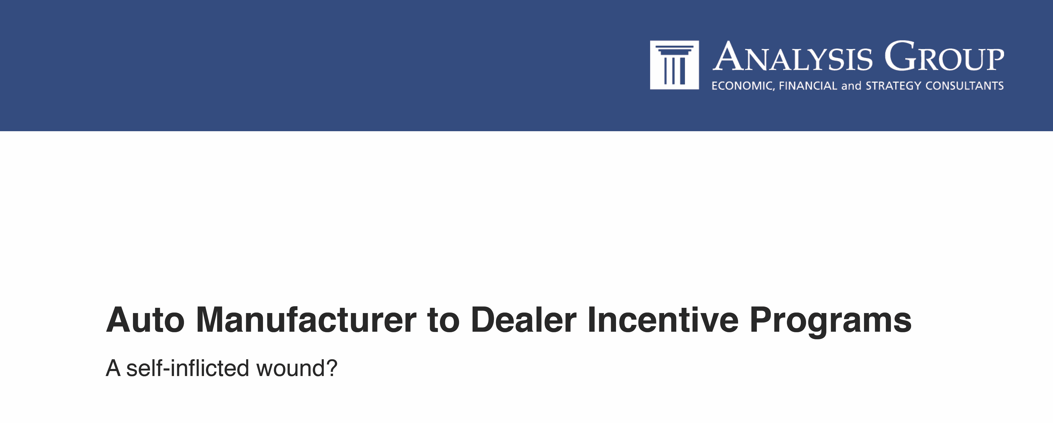
Late 2017: The latest research

Slide 25
Potential Elements of a Conditional Incentive Program
Showroom floor tile
Service Advisor Desk
Greeting/Reception Desk
Business Cards
Website(s)
Car Spacing in Showroom
Lawn/Grass Height
Dress Code
Mystery Shop Program
Reputation Management
% Off-Lease Vehicle Purchase
License Plate Holders
Certified Training (10+ categories!)
TVs
Captive Advertising
WiFi
Charging Stations
“Clutter” measurements
Media Players
iPads

Slide 26
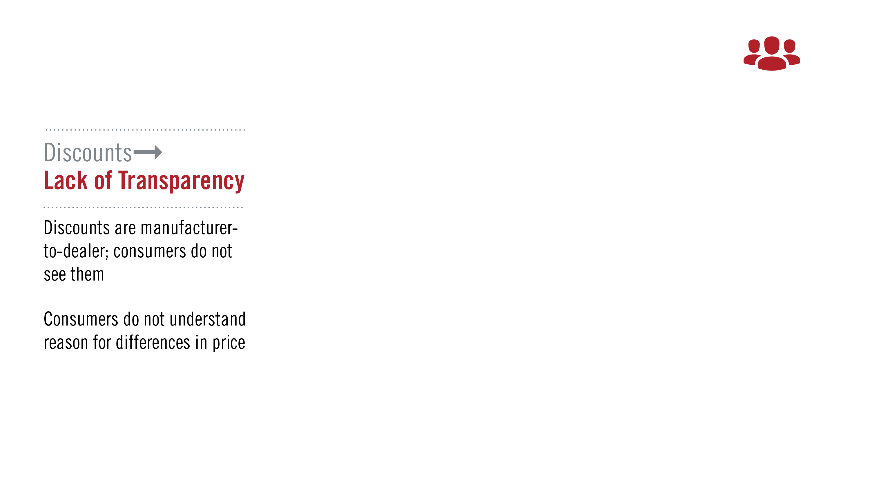
Unintended Effects: Consumers

Slide 27
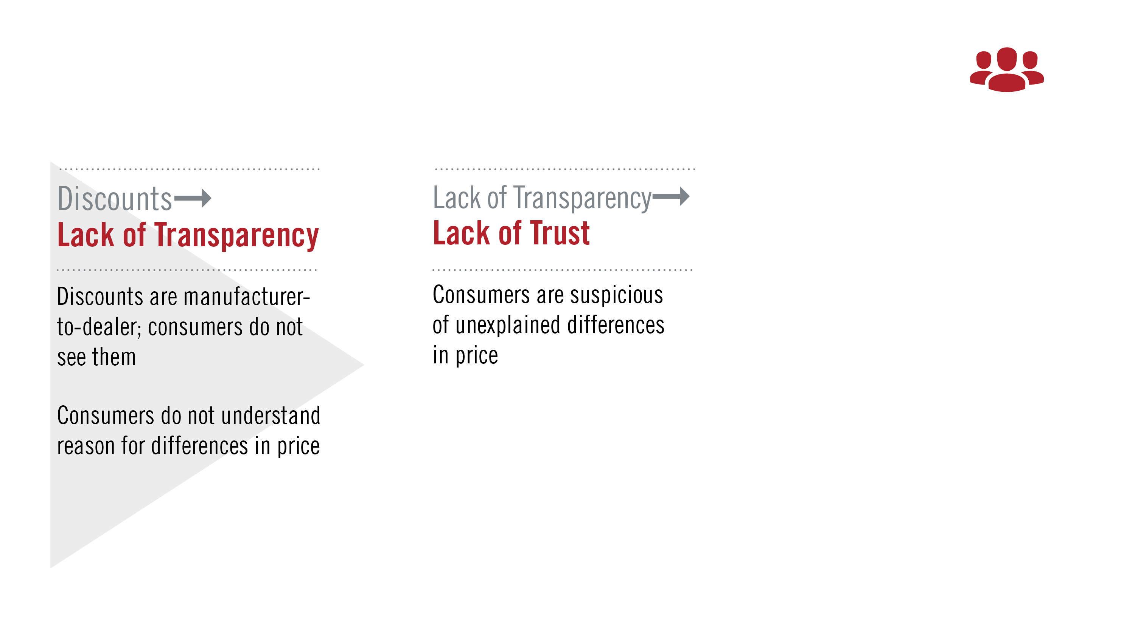
Unintended Effects: Consumers

Slide 28
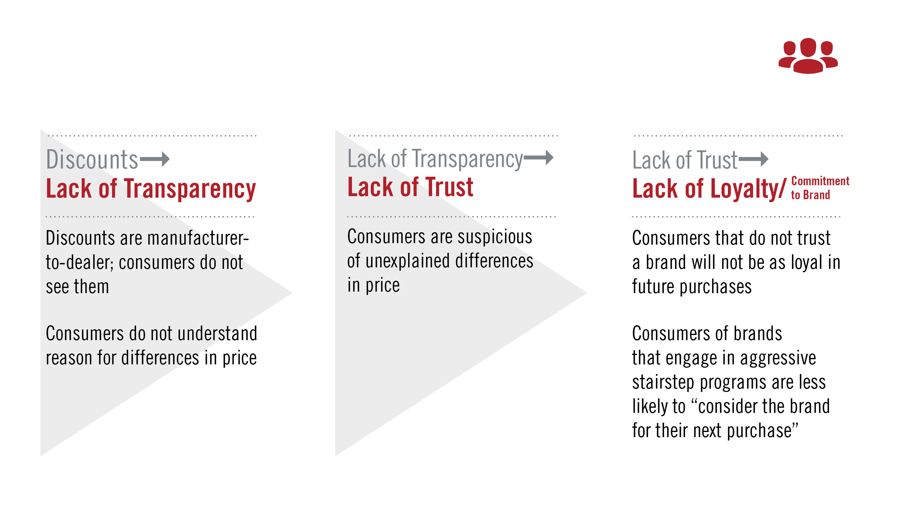
Unintended Effects: Consumers

Slide 29
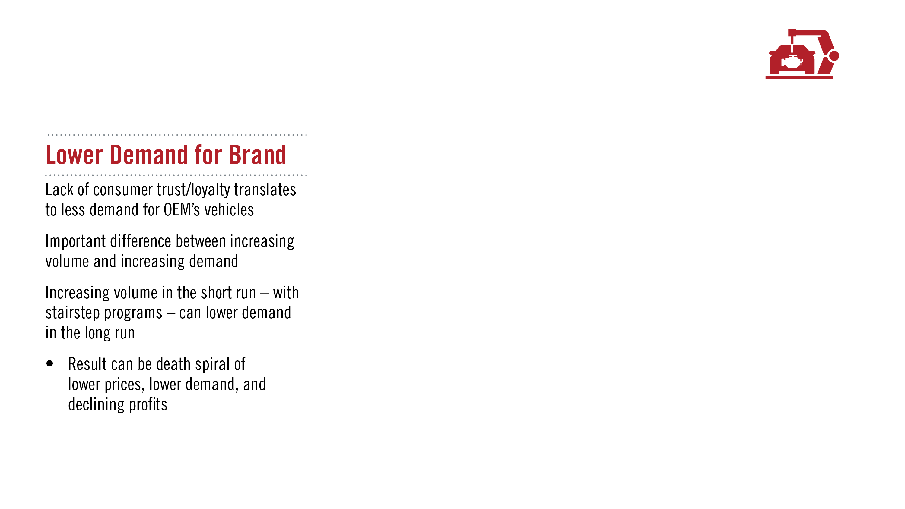
Unintended Effects: Manufacturers

Slide 30
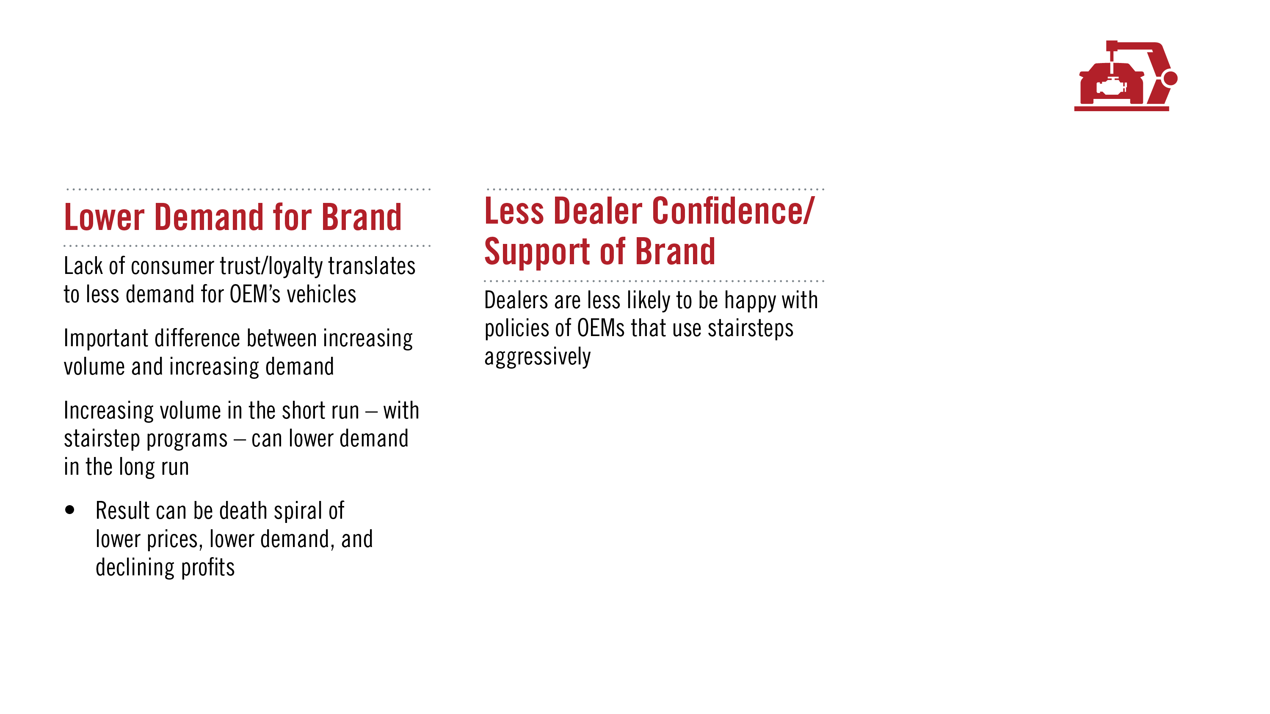
Unintended Effects: Manufacturers

Slide 31
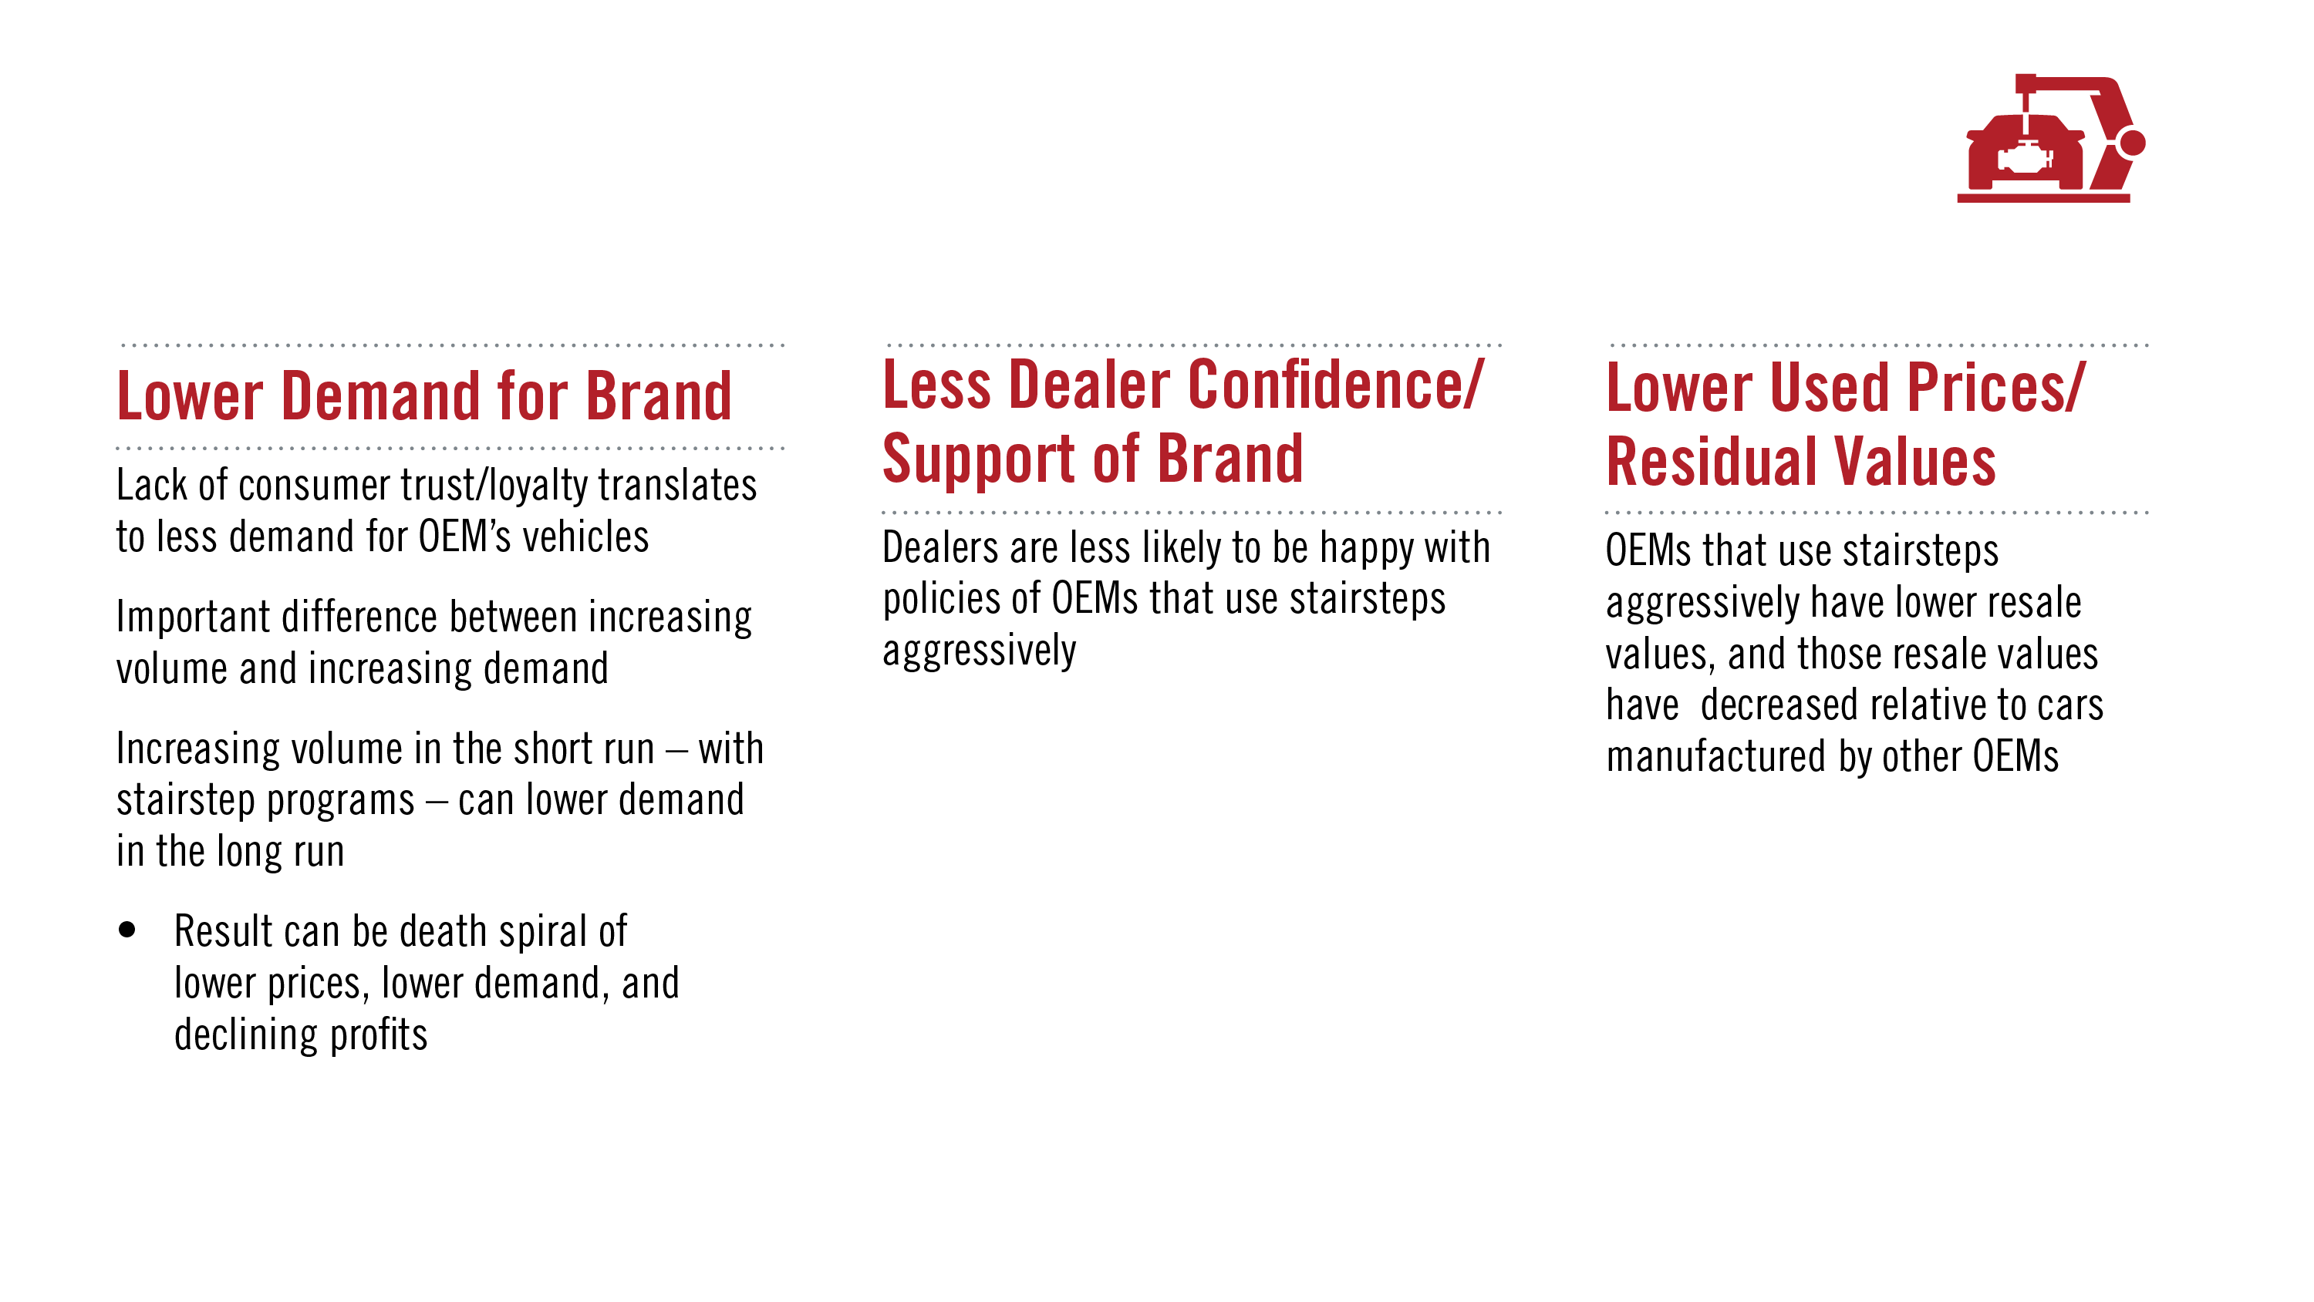
Unintended Effects: Manufacturers

Slide 32
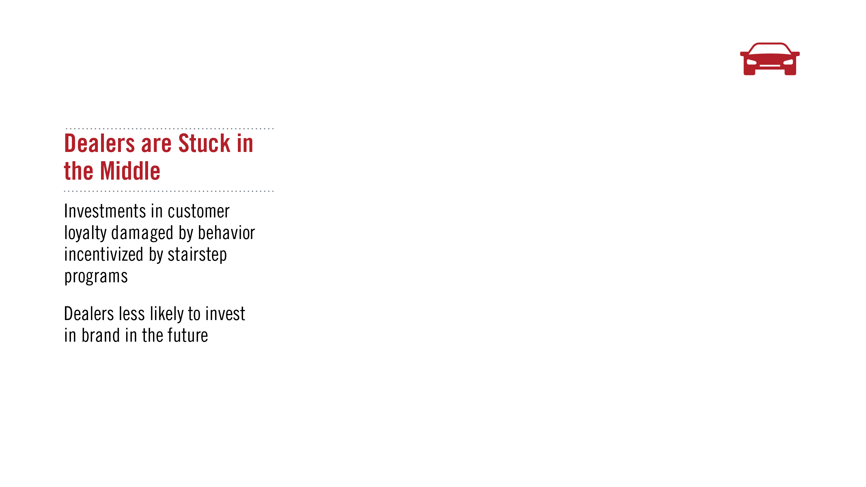
Unintended Effects: Dealers

Slide 33
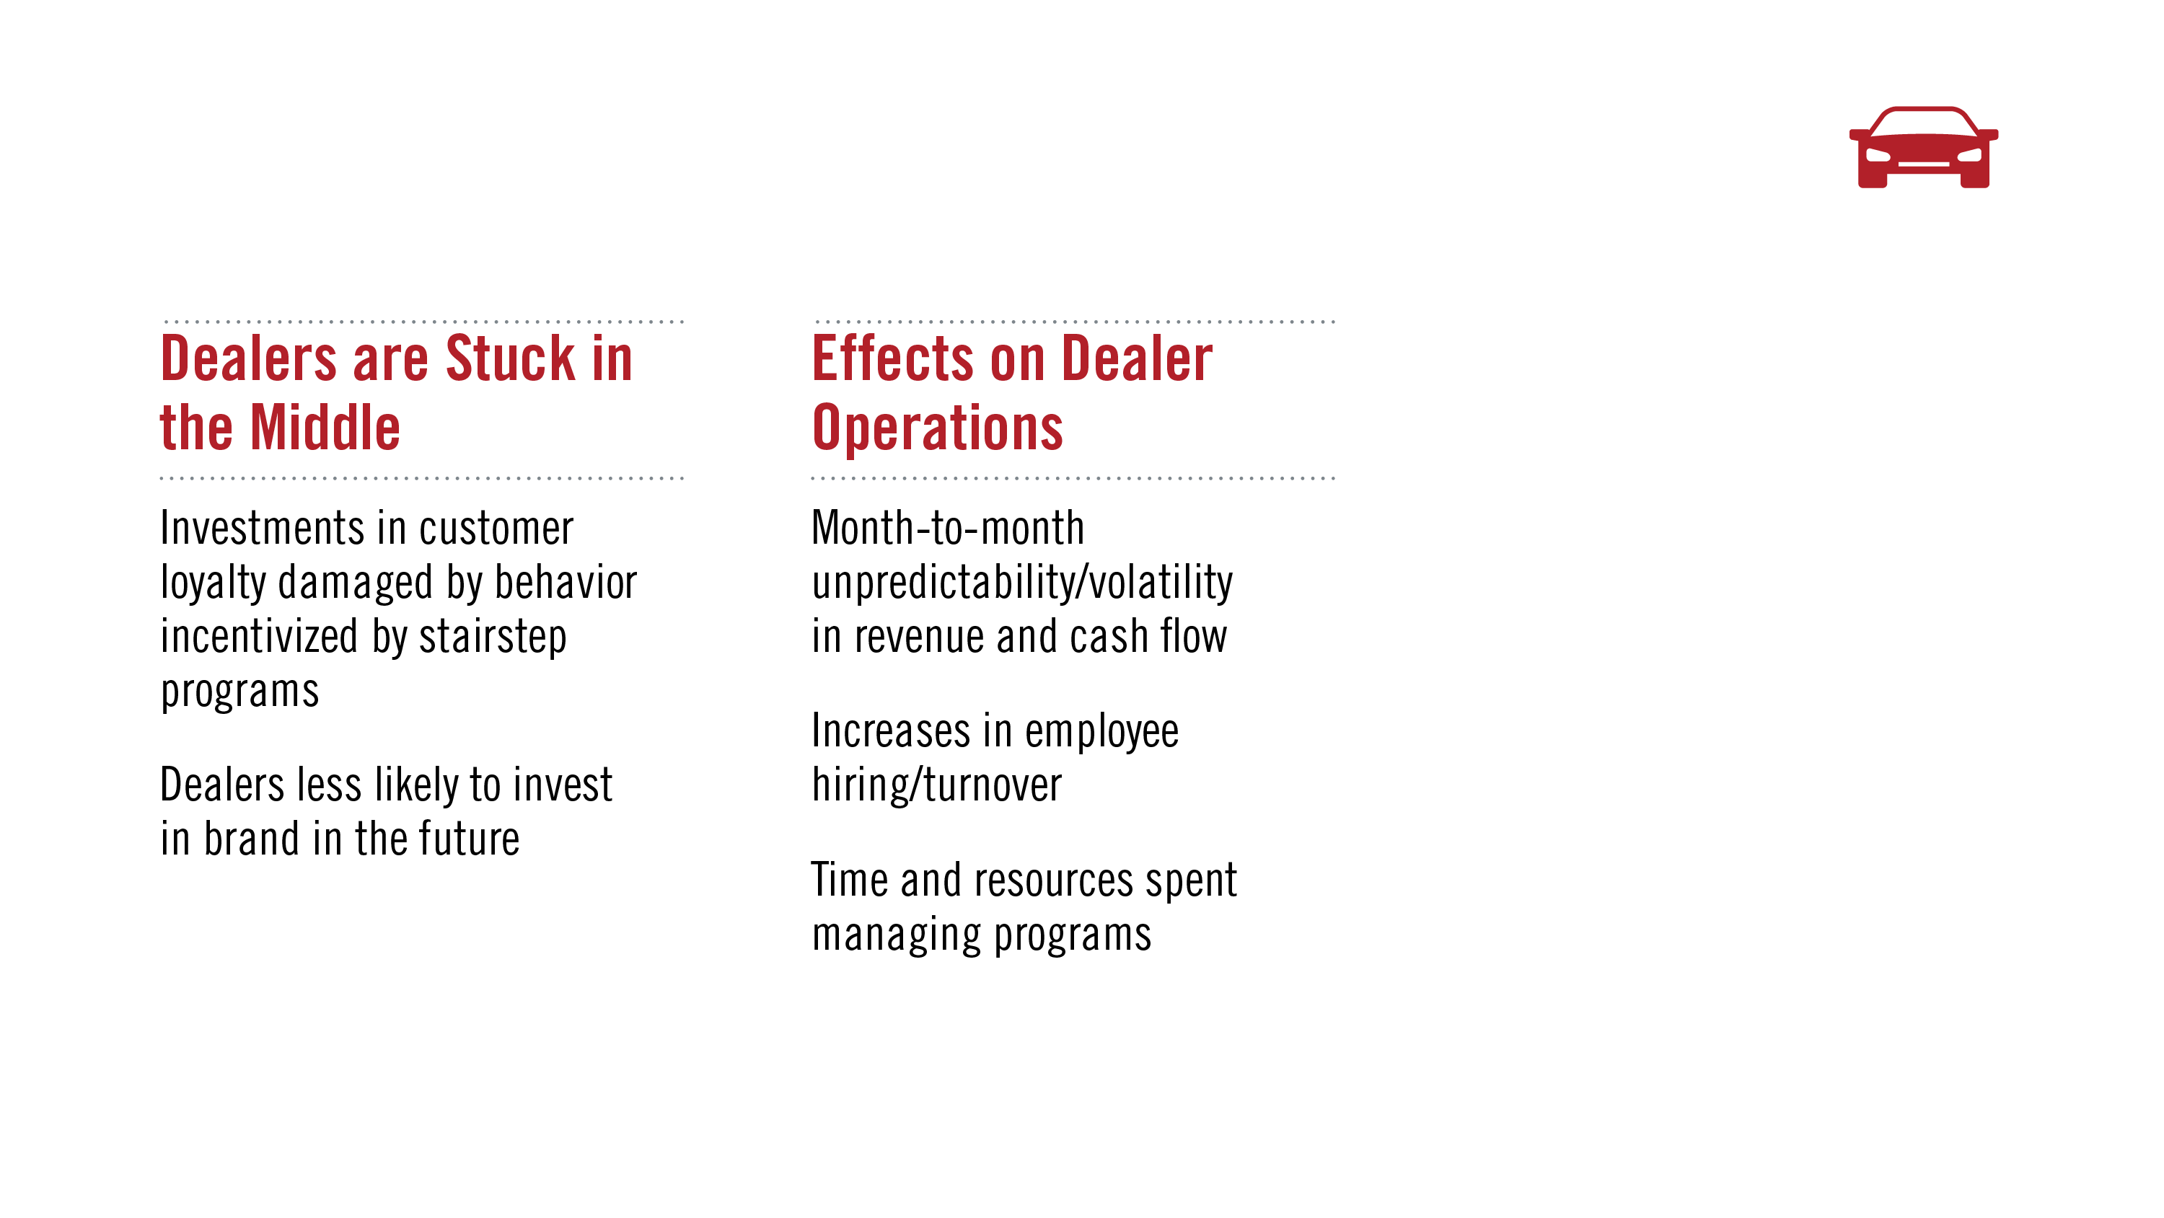
Unintended Effects: Dealers

Slide 34
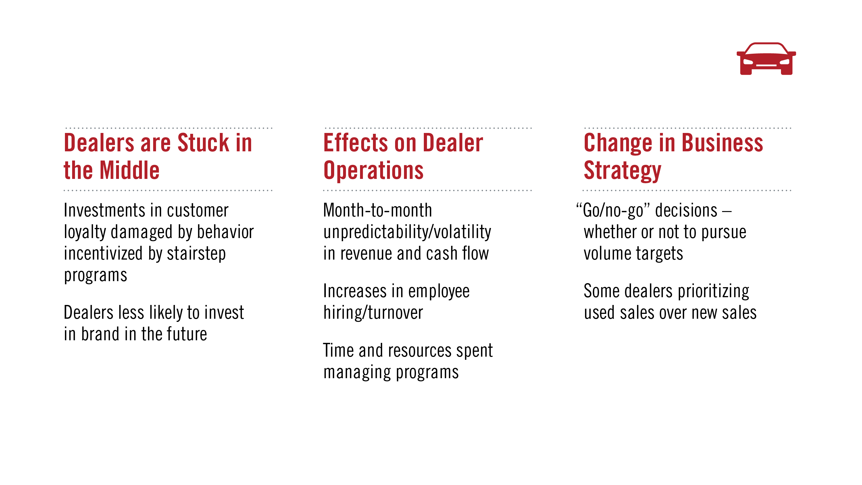
Unintended Effects: Dealers

Slide 35
What about
Positive Outcomes of
Conditional Incentives?

Slide 36
Key Questions
Does it help the bottom line?
Do dealers perceive more value for their operations?
Does it help dealers recognize more value for their dealership?
Are there intangible benefits?

Slide 37
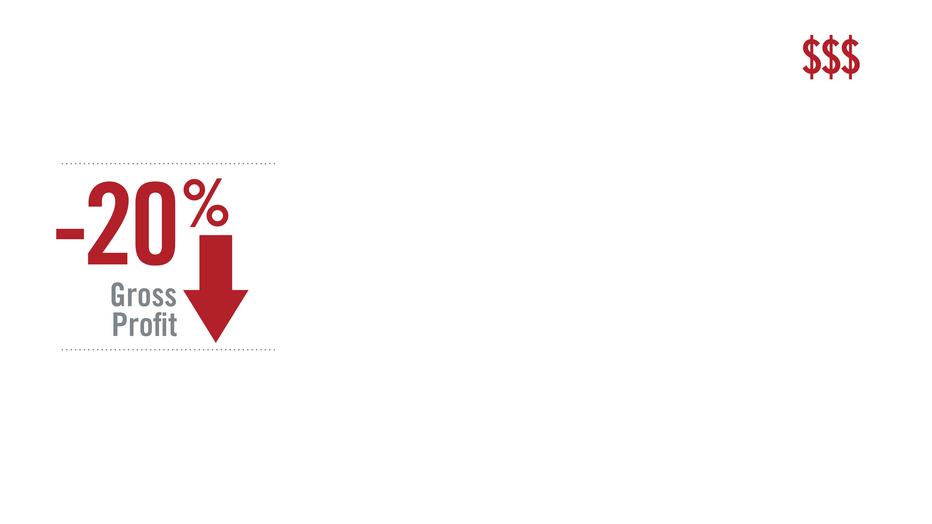
Financial Trends
YE2009 to YE2017. All figures as percent of sales based on average dealer performance.
Source: NADA

Slide 38
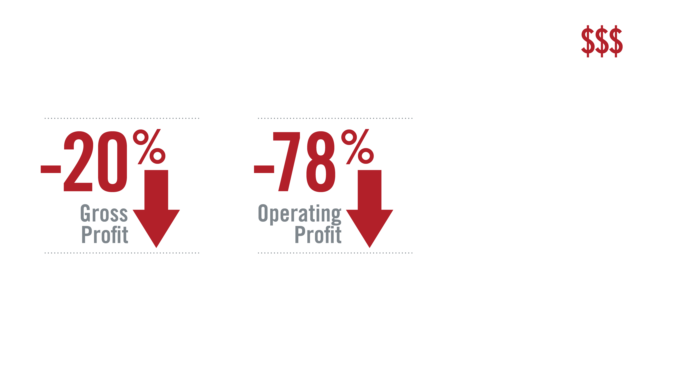
Financial Trends
YE2009 to YE2017. All figures as percent of sales based on average dealer performance.
Source: NADA

Slide 39
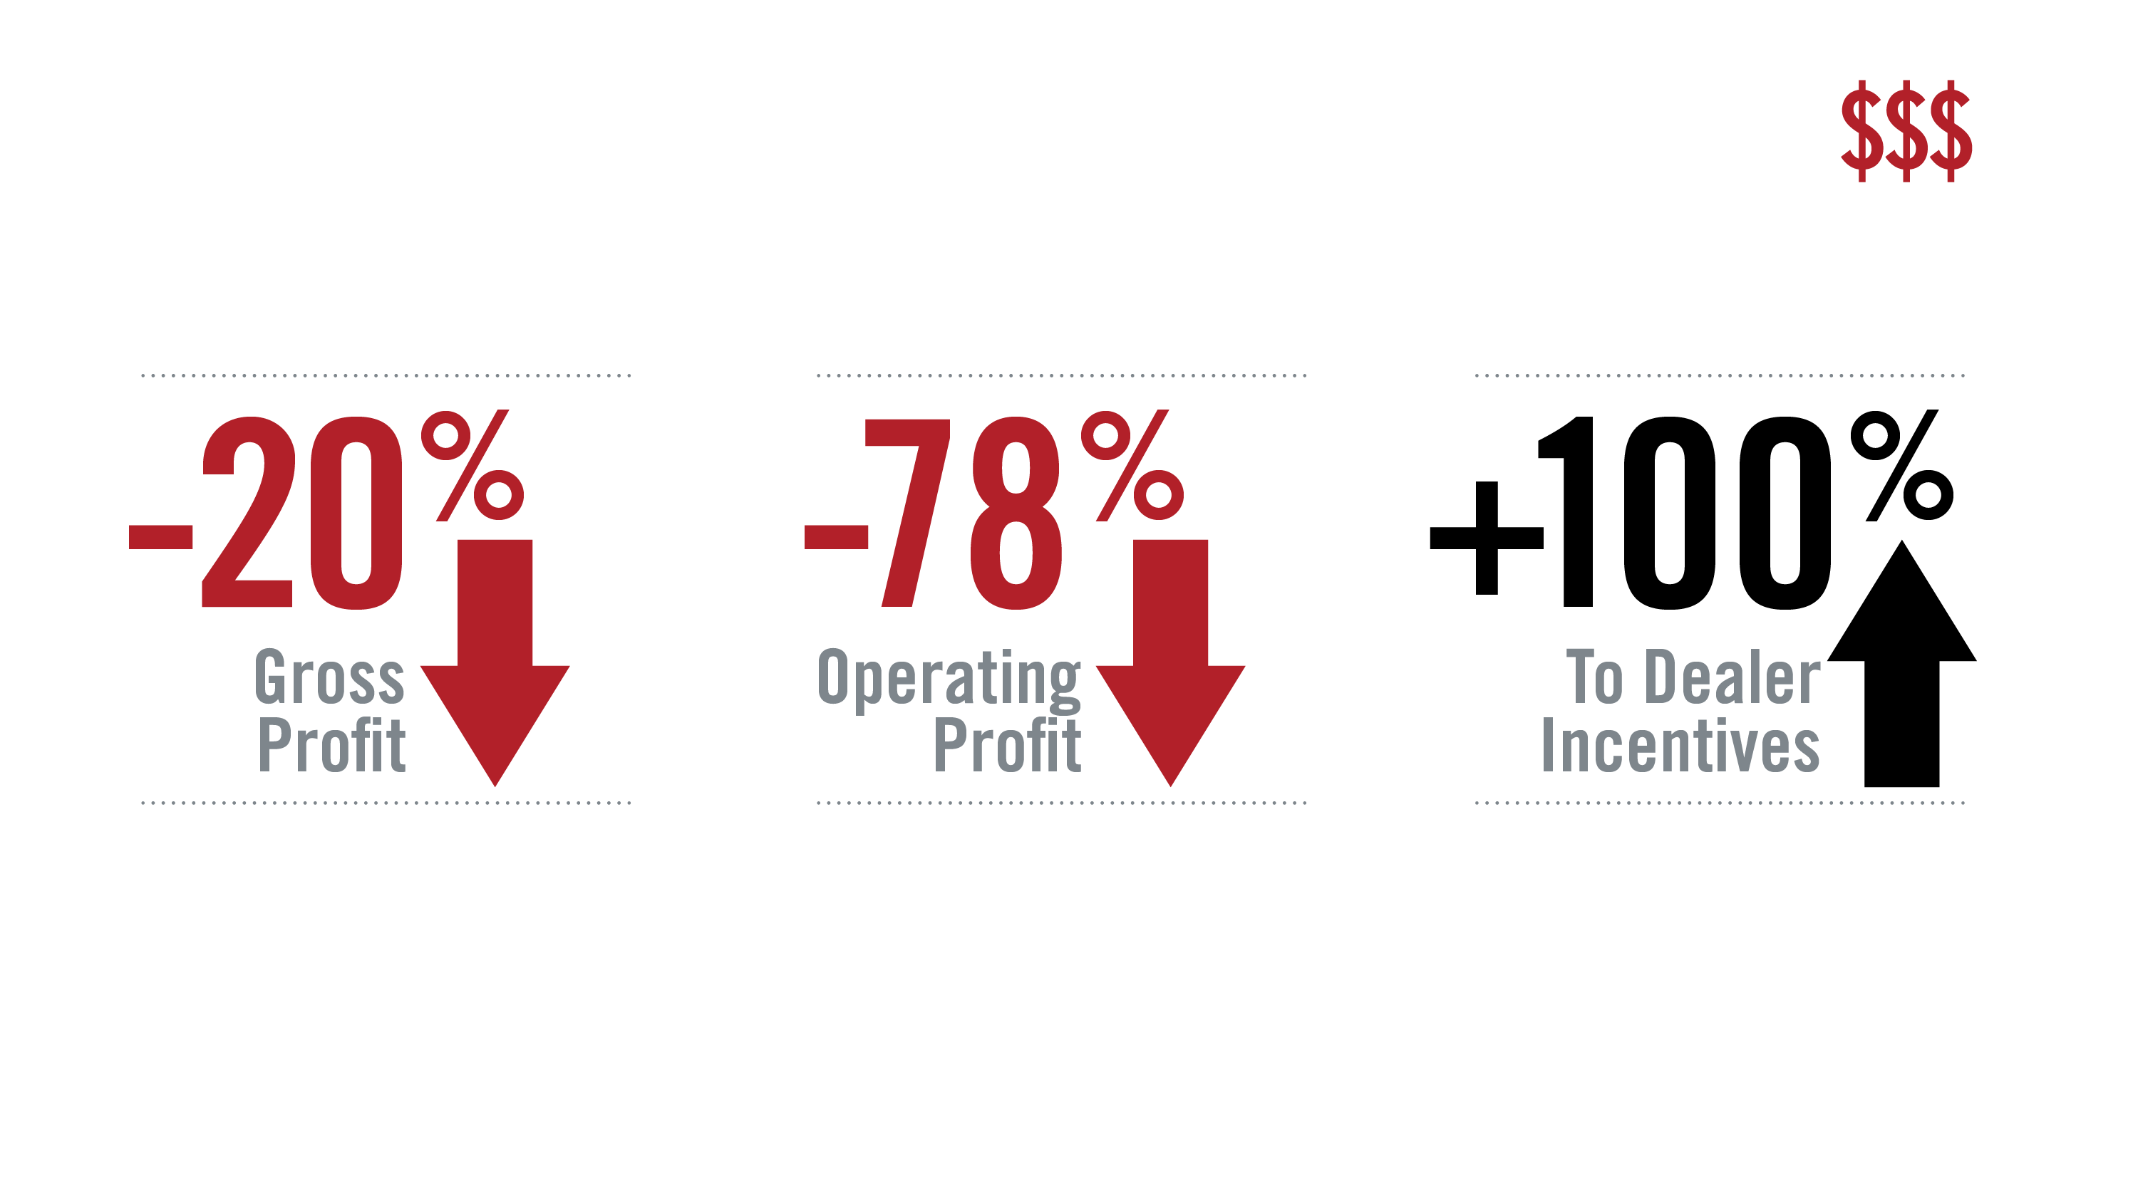
Financial Trends
YE2009 to YE2017. All figures as percent of sales based on average dealer performance.
Source: NADA

Slide 40

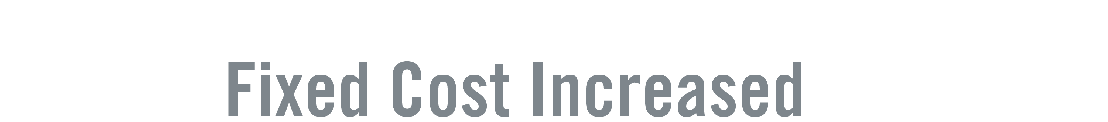
The Scary, Financial Truth

Slide 41


Complexity vs. Franchise Value: Perceived Value

Slide 42


Complexity vs. Franchise Value: Perceived Value

Slide 43
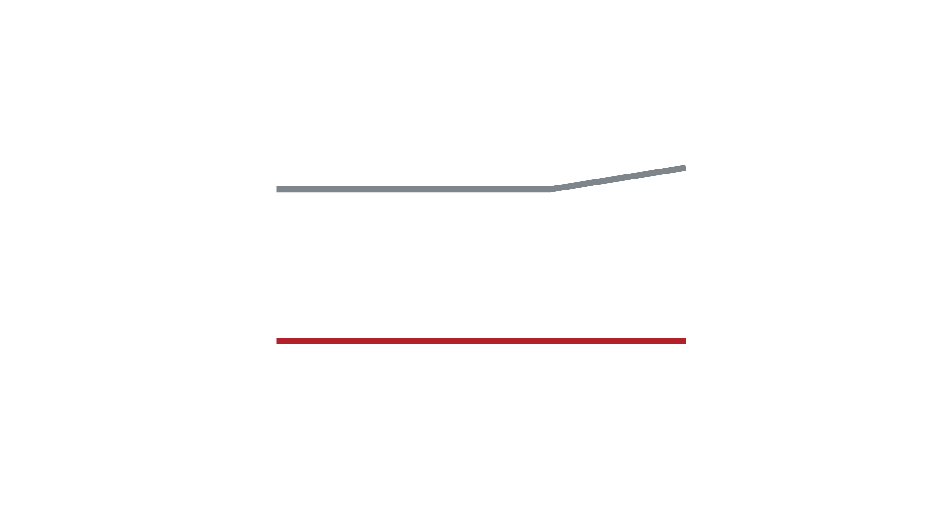
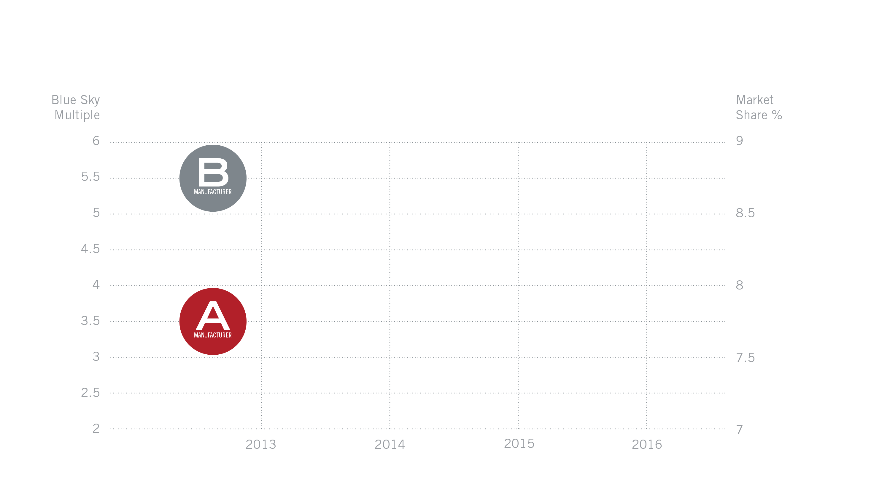
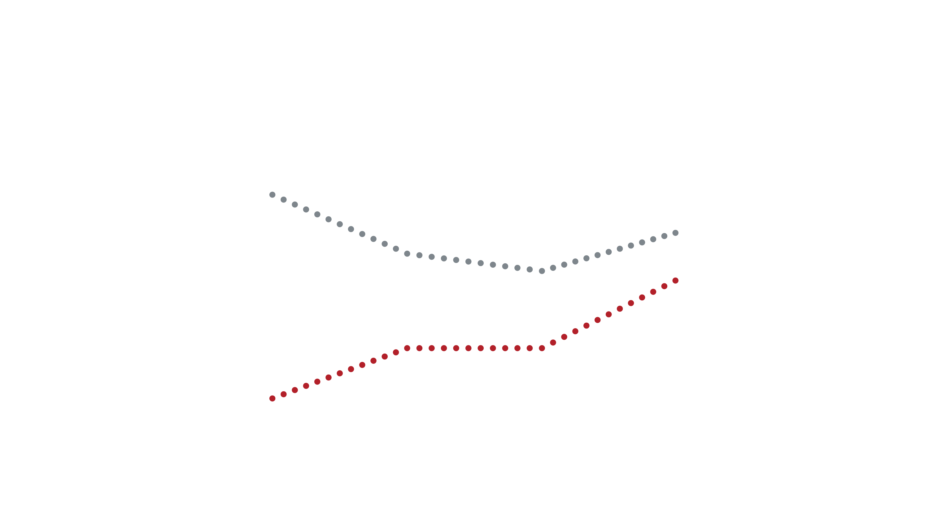
Market Share vs. Blue Sky: Realized Value
Notes: The chart shows the behavior of market share (dashed line) and Blue Sky multiples (solid line) for two types of manufacturers over the 2013-2016 period. “Manufacturer A” relies extensively on stair-step programs, while “Manufacturer B” does not.
Sources: [A] “The Blue Sky Report,” Haig Partners. [B] Automotive News.

Slide 44

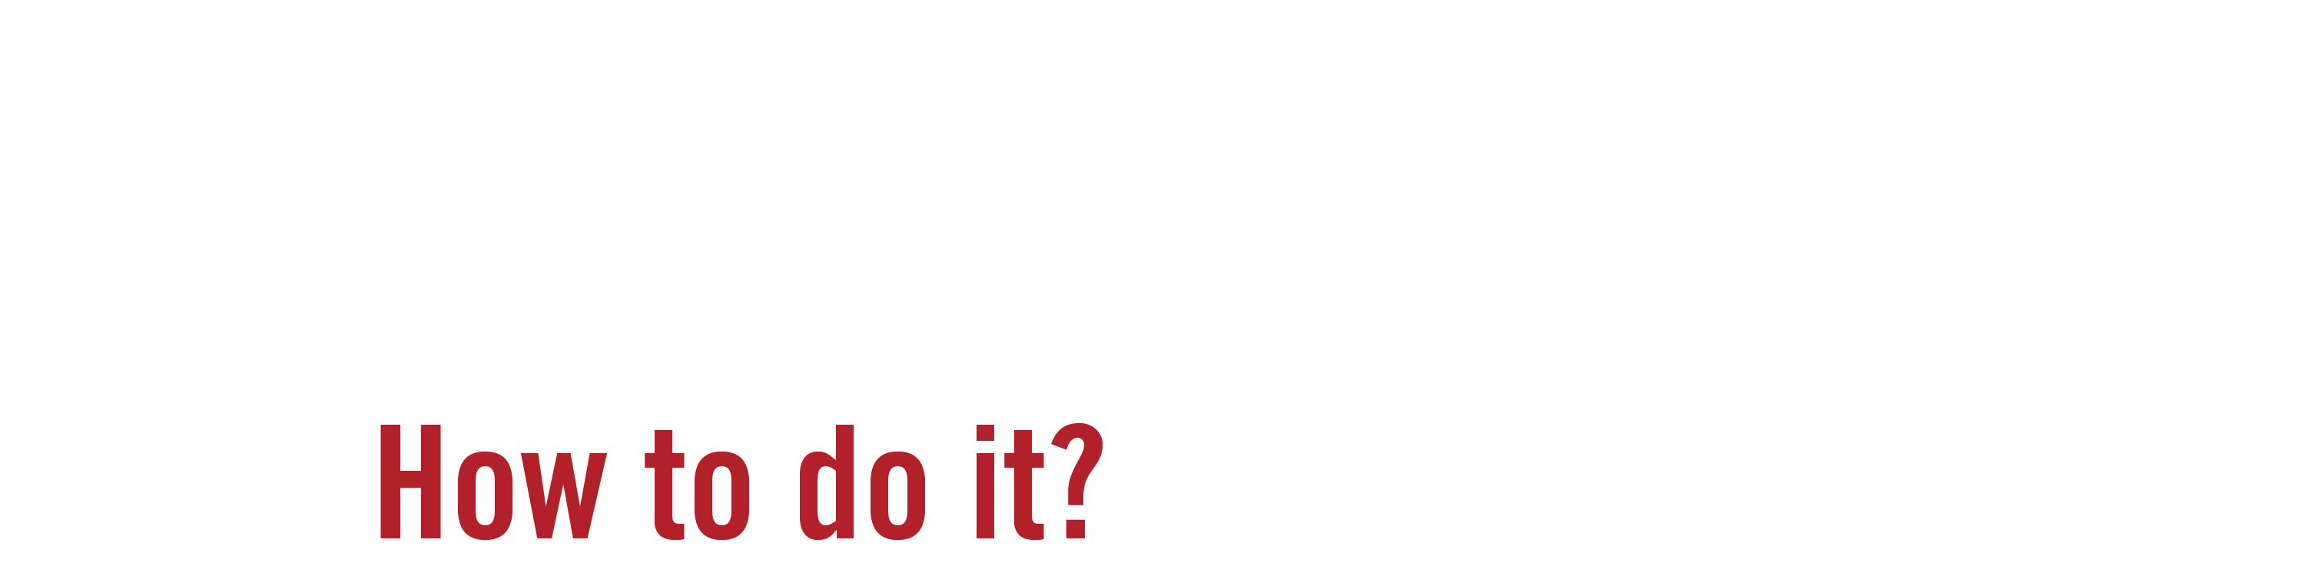


Philosophical Differences

Slide 45
The Legal Controversy
  Negative View:
      Act as wholesale price reductions for some, but not all, dealers
      Violate federal and state "price discrimination" laws
  Positive View:
      Reimburse dealers for investments made, rather than additional "cash"
      Available to all dealers on a "proportionally equal" basis, and lawful

Slide 46
The Business Debate
  Positive Story: Support and reimbursement for dealers who invest in their dealerships?
  Negative Story: Impact on dealers' business models?

Slide 47
Perceived Benefits – The Positive Story
  Encourage dealerships to . . .
      Improve their facilities and brand representation
      Promote the brand in a similar manner at every location
      Improve customer experience
  Support and reimburse dealers who already have invested in brand
      Address the "free rider" problem (no dealer benefits from another's investment)
  Allow a brand to compete more strongly on an inter-brand basis
      Brand competes not just on product, but also on brand experience
  Lead to more valuable stores
      Stronger Brand = Increased Brand Sales = Heighten "blue sky" values

Slide 48
Perceived Drawbacks – The Negative Story
  Compel dealerships to . . .
      Make investments they do not want to make
      Represent a brand in a manner inconsistent with their own business plan
  Do not lead to higher sales
      "Brick and Mortar" do not sell vehicles; dealers sell vehicles
  Impact intra-brand competition by giving some dealers a price advantage
      Dealers who satisfy standards can use margin payments to support intra-brand price competition
  Lead to less valuable stores
      Heighten Manufacturer Standards = More Investments Required = Lower "blue sky" values

Slide 49


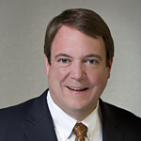
Questions?
Randall Oyler
Partner
Quarles & Brady
T. 312.705-5070
E. randall.oyler@quarles.com
Todd Milbury
Managing Director of Industry Relations
National Automobile Dealers Association (NADA)
T. 703.821.7000
E. industryrelations@nada.org
Joseph Roesner
President
The Fontana Group, Inc.
T. 520.325.9800
http://www.fontanagroup.com/

