Slide 1
RV Industry Update
NAMVBC’s Fall 2018 Workshop
New Orleans, LA

Slide 2
Your Presenter: Christine Siksa Director, Government Affairs csiksa@rvia.org

Slide 3
Who is the RV Industry Association?
We are the unifying force for safety and professionalism within the RV industry. We work with federal and state policymakers to promote and protect the RV industry and our members.

Slide 4
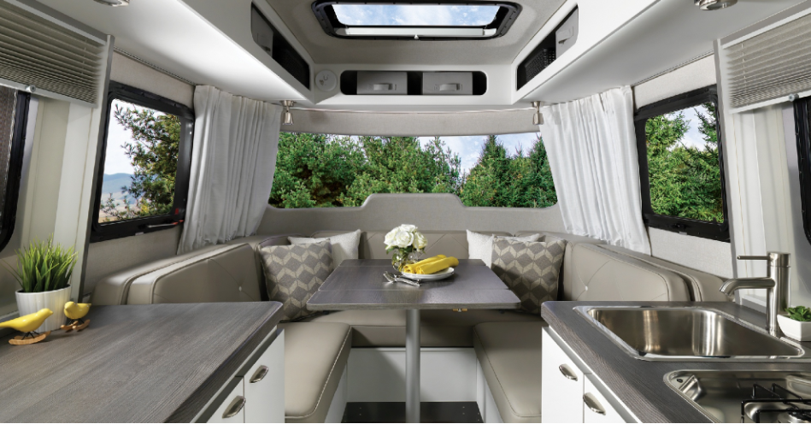
The RV Industry…
Has an economic impact of $50 billion annually in the U.S. economy (2015)
Supports approximately 300,000 full-time jobs
Pays $15.8 billion in wages
Pays $5.7 billion in taxes
Shipped 506,000 units to dealers in 2017

Slide 5
RV Industry Association
The RV Experience – RVX
RV Technical Institute – RVTI
Statistics & Research
Industry Standards & Inspections
GoRVing
New website at www.rvia.org

Slide 6
Types of Recreation Vehicles

Slide 7
State Legislative Initiatives

Slide 8
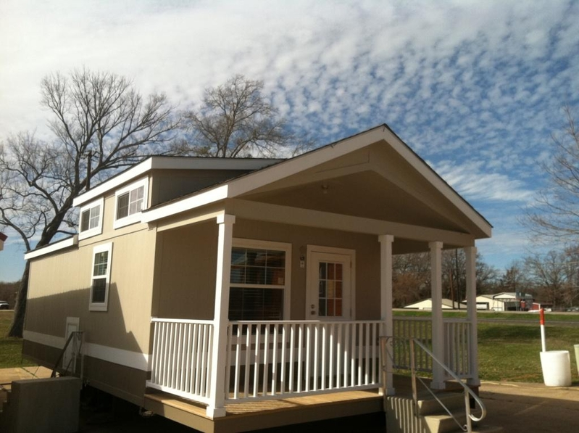
State Legislative Initiatives
Remove RVs from car franchise laws in favor of RV-specific manufacturer-dealer laws but maintain state licensing and oversight
Standardize RV definitions, dimensions, registration and titling, including for Park Model RVs
Common rules for RV Transporters
State adoption of federal motorhome
axle weight exemption

Slide 9
Federal Initiatives

Slide 10
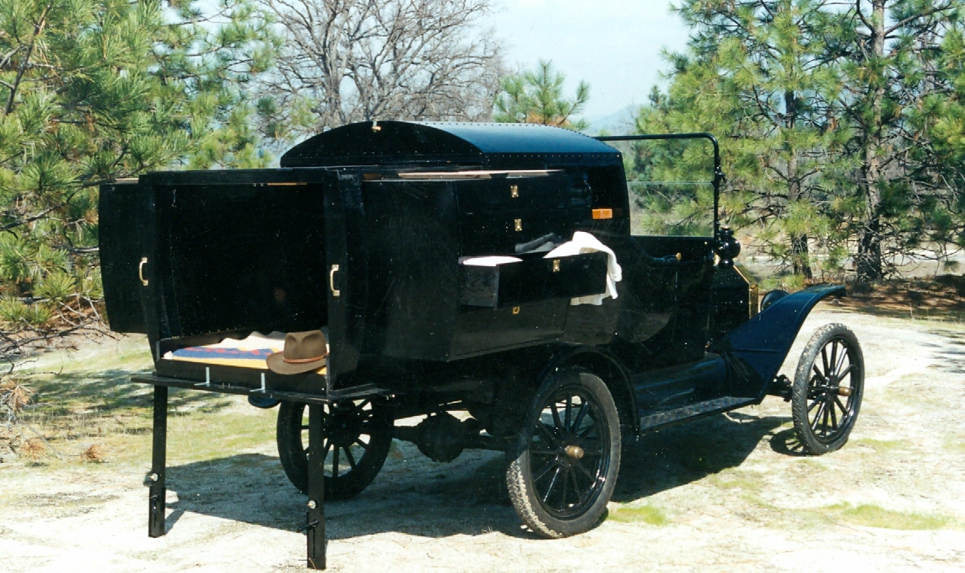
Federal Initiatives
Outdoor Recreation Roundtable – ORR
Campground modernization and expansion through public-private partnerships
State Directors of Outdoor Recreation
Passage of federal and state legislation which supports these initiatives
Trade and Tariffs
Countervailing duties, anti-dumping, steel,
aluminum, wood, tires, more…

Slide 11
Need a solution? Have questions about RVs or our industry?
Christine Siksa 571-665-5870 (State)
Mike Ochs
571-665- 5860
(Federal)

